Slide 1
KNOWLEDGE COMPONENT: MODULE 2: SUGAR PROCESSING EQUIPMENT AND TECHNOLOGY: KT2: RAW AND REFINED SUGAR PROCESSING EQUIPMENT AND TECHNOLOGY

Slide 2
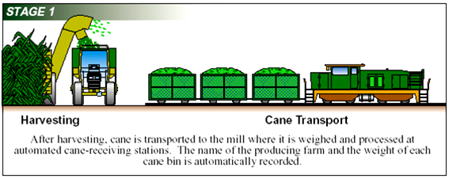
Cane Handling Equipment

Slide 3
Cane Handling Equipment
Cane is either mechanically or manually harvested
Cane must be processed as soon as possible after harvesting
Cane Transport
  Cane is loaded onto cane carts or trailers in the field
  Transported to mills in special trucks called Hilos, on tractor trailers or by train
Weighing and Off-Loading
  Cane trucks are weighed on a weigh-bridge before it enters the fctory yar
  Cranes unload the trucks
  Cane is loaded onto an upward inclined cane table or spiller table
  The cane table is a chain or slat conveyor
  The cane is fed onto the cane carrier which is a steel slat carrier or rubber conveyor belt
  Empty trucks are weighed again when they leave the yard
  Gross and Nett weight, together with the name of the grower, is noted on the weighbridge ticket

Slide 4
Cane Handling Equipment (cont.)
Excessive soil and rocks are removed
The cane is cleaned by:
  Flooding the carrier with warm water or
  Spreading the cane on agitating conveyors that pass through strong jets of water and combing drums.
At this point, the cane is clean and ready to be milled.

Slide 5
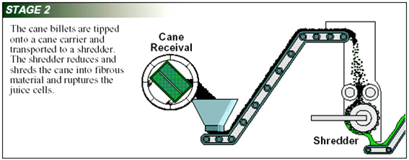
Cane Preparation

Slide 6
Cane Preparation - Shredders
Cane is fed to one or two sets of cane knives that chop the cane into short lengths
These short lengths enter shredder which tears cane apart using large metal bars known as hammers
A constant thickness of the cane blanket must be maintained
The task of the mills and diffuser is to extract as much juice from the cane as possible
The walls of the cells must be ruptured before the juice can flow out
This is done by exerting pressure on the cane, between rollers

Slide 7
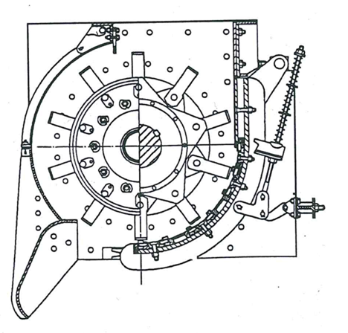
Cane Preparation - Shredders (cont.)
To apply pressure on the cane evenly the blanket of cane must be of uniform thickness
Uniform thickness is ensured by cutting the cane into shreds and small pieces by a leveller
A leveller is a set of rotating cane knives turning just above the horizontal part of the carrier
There is a leveller before the shredder and another leveller after the shredder
The shredder consists of a set of rapidly revolving hammers which beat the cane into a fluffy mass
No juice is extracted by the shredder

Slide 8
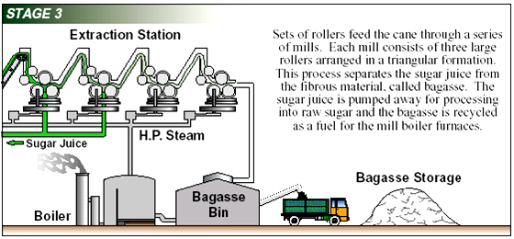
Milling

Slide 9
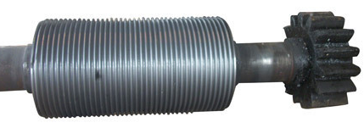
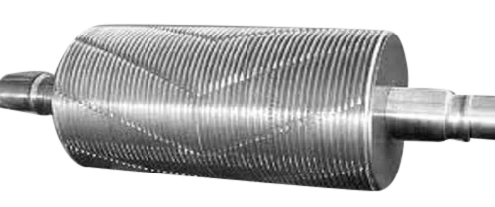
Milling
Pulverised cane from the shredder is fed to a diffuser (or milling train).
The extraction plant consists of six or seven roller mills called the milling train or tandem.
Each mill consists of three rollers.
Each roller has a shaft and a shell with grooves, driven by a steam turbine or electric motor through a set of gears.

Slide 10
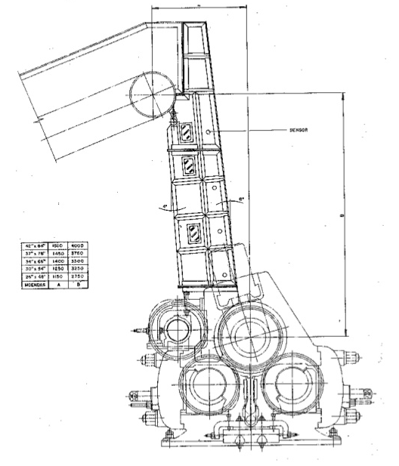
Milling (cont.)
Prepared cane is fed to the mills by vertical Donnelly chutes and a feeder drum and enters the opening between the front and the top roller, where the juice is extracted.
Mill rollers rotate slowly, at about 2.5 to 3.5 r.p.m.
Extracted juice flowing down the feed rollers and delivery rollers is collected in a juice tray.
A Donnelly chute above a mill roller arrangement

Slide 11
Milling (cont.)
Juice is screened to remove fine bagasse and weighed
Before the last mill bagasse is mixed with imbibition water thus diluting the juice squeezed out in the last mill
The residue leaving the last mill is called bagasse
Bagasse is transported to boilers

Slide 12
Diffusion (Imbibition)
Imbibition water is poured onto the cane from above
The water percolates through the bed of cane and dissolves the sugar
The water-sucrose mixture is called mixed juice
It is collected in a hopper and pumped back to the bagasse layer just in front of where the water was applied

Slide 13
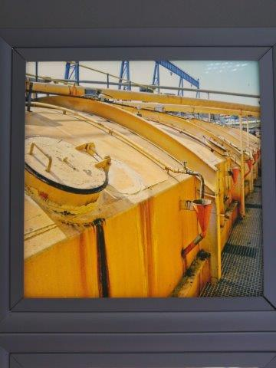
Diffusion (Imbibition) (cont.)
Repeated several times until it reaches the inlet of the diffuser
This diffuser juice is pumped to the boiling house via a juice scale
The mixed juice is screened to remove fine particles and massed
Definition: Imbibition is a special type of diffusion when water is absorbed by solids-colloids causing an enormous increase in volume

Slide 14
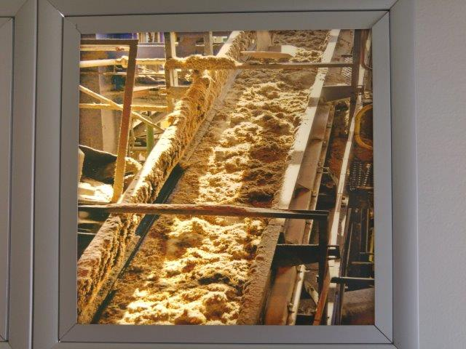
Diffusion (Imbibition) (cont.)
Bagasse leaving the diffuser has a high moisture content
Transported to a de-watering mill
Squeezed between two rollers before being used as fuel in the boilers
Bagasse leaving the diffuser

Slide 15
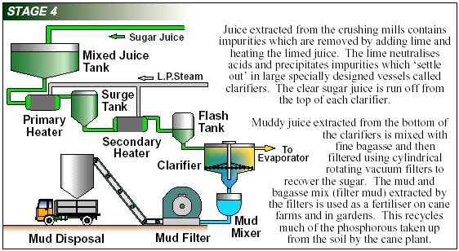
Juice Purification

Slide 16
Juice Purification
Mixed juice and crushed juice is mixed, screened of bagasse particles and weighed
Mixed juice is cloudy, grey- or greenish, foaming, water content 80 – 84%
Contains sand particles, fine bagasse particles, cane wax and air bubbles
Mixed juice must thus be purified to produce raw sugar

Slide 17
Juice Purification (cont.)
Mixed juice is purified by:
  Heating to +/- 104°C
  Liming of mixed juice (defecation process)
  Settling of mud
  Decanting of the clear juice
  Filtration of the mud

Slide 18
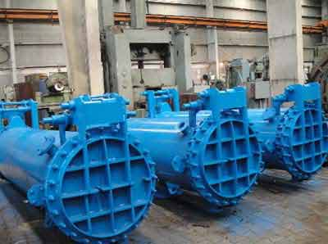
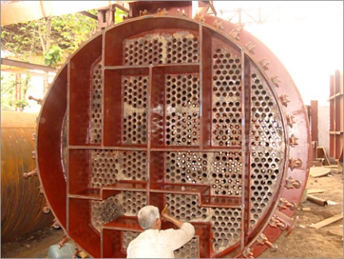
Juice Purification (cont.)
Primary heating to 70°C with vapour from evaporators
Secondary heating to 104°C with exhaust steam
Juice heater consists of a steam chest with tubes through which the juice flows and around which steam is present
Juice flows back and forth until heated to 104°C
Juice is limed to 7.5pH
Passes through the in-line mixer before entering a flash tank
Exposed to atmospheric pressure to remove air bubbles

Slide 19
Juice Purification (cont.)
Milk of lime is added in a perry tank
From the perry tank the mixed juice is pumped to a clarifier tank where a precipitate settles out i.e. it removes the suspended solids from the juice
The clear juice must be kept at a pH of 7.2
The “mud” that settles out is removed by scrapers to a mudwell and the mudbox and then on to a vacuum where any remaining juice is returned to the mixed juice
This clarification step removes most of the non-sugars
Some flocculants can be added to improve settling of juice in the clarifier
The cake that results from the vacuumed mud is returned to fields as fertiliser

Slide 20
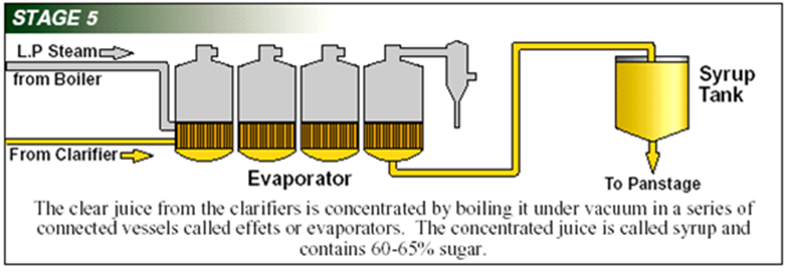
Juice Concentration

Slide 21
Juice Concentration - Evaporators
Clear juice from the clarifiers is pumped to the evaporators
Steam is used to heat the juice
Water is evaporated until the juice is concentrated to a thick syrup
The pH is between 6.8 and 7.0
Sugar content is 12 to 14%
Considerable amounts of water must now be removed by evaporation
First stage – only water is evaporated
Second stage – water is evaporated and sugar is crystallised (vacuum pans are required)
Multiple effect evaporation uses the heat of the vapour of the first evaporator to boil the juice of the second evaporator at a lower pressure and the vapour of the second evaporator to boil the juice of the third evaporator at a lower pressure and so on.

Slide 22
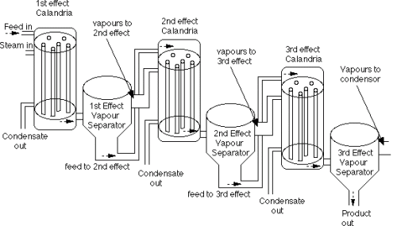
Juice Concentration- Evaporators (cont.)

Slide 23
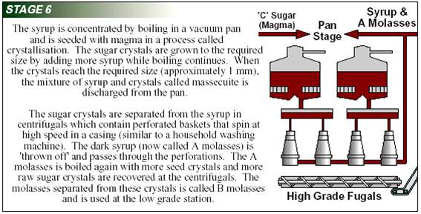
Juice Concentration - Crystallisation

Slide 24
Juice Concentration - Crystallisation
From the evaporators, syrup is sent to a multi-stage tank and then to the Pan Boiling floor
Pan boilers or vacuum pans are special evaporators
The sugar in solution is forced to crystallize by evaporating water
The sugar concentration increases until the saturation point is reached
Sugar crystals are grown in the solution
The solution is called mother liquor
The mixture of crystals and mother liquor is called massecuite
The sugar crystals are separated from the massecuite in centrifugals and the remainder is known as molasses

Slide 25
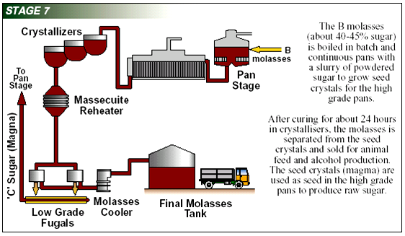
Juice Concentration – Molasses removal

Slide 26
Juice Concentration – Molasses Removal
The mixture of crystals and mother liquor is called a “massecuite” and, when the crystals are large enough the pan is emptied (struck) into large stirred tanks (A-crystallisers) and allowed to cool for some hours.
The steps are designated by letters of the alphabet: A, B and C.
The Strike made from syrup is called “A” Strike, which is separated into “A” molasses and “A” sugar.
The Strike boiled from “A” molasses is called “B” Strike (Massecuite).
In the same way finally a “C” Strike is made from “B” Molasses, from which the final molasses is produced.
For certain reasons some syrup is sometimes used besides “A” and “B” molasses, to boil a “B” or “C” strike.

Slide 27
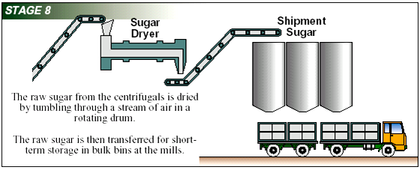
Juice Concentration – Sugar Drying

Slide 28
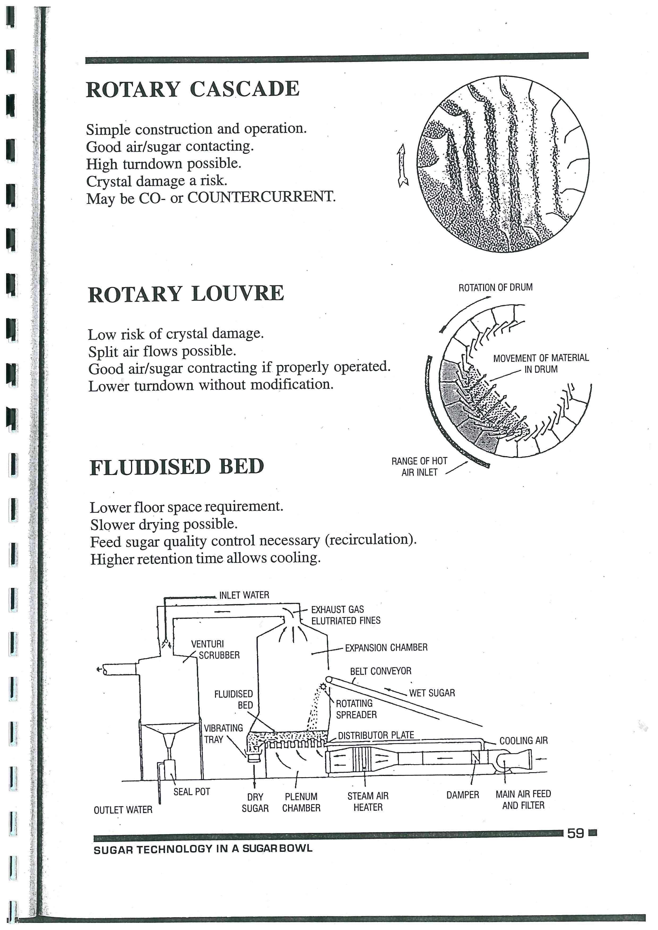
Juice Concentration – Sugar Drying
Sugar is dried and cooled to reduce microbiological activity and to prevent caking.
Sugar discharged from the “A” centrifugals falling on a reciprocating conveyor, is moist and hot and has to be dried before being sent to storage or to the packing station.
A bucket elevator transports the sugar from the conveyor up to the sugar drier.
There are different types of driers
After drying, sugar is packaged

Slide 29
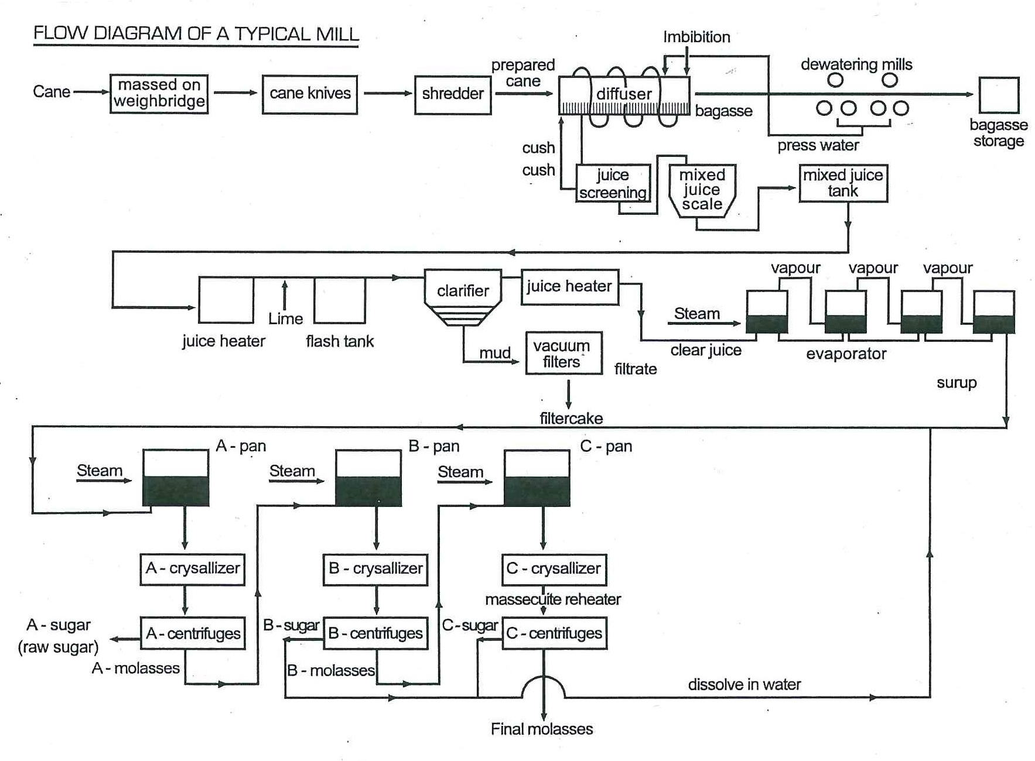
Flow Diagram of Typical Mill

