Slide 1
KNOWLEDGE COMPONENT: MODULE 2: SUGAR PROCESSING EQUIPMENT AND TECHNOLOGY: KT3: INTRODUCTION TO MECHANICAL SYSTEMS

Slide 2
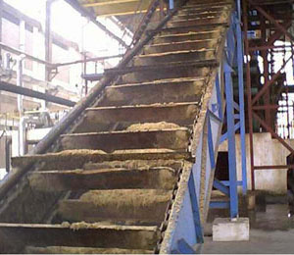
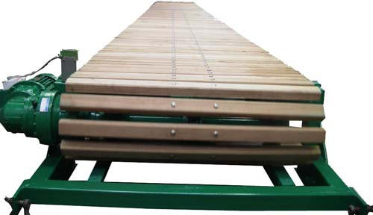
Material Handling Equipment
Material handling equipment is all equipment that relates to the movement, storage, control and protection of materials, goods and products throughout the process of manufacturing, distribution, consumption and disposal.
Material handling equipment is used to:
  increase throughput,
  control costs, and
  maximize productivity
Types of Material Handling Equipment includes:
  Actuators – converts energy into torque
  Elevators
  Conveyors (Slat or rake type)

Slide 3
Pumping Systems - Pipes
Pipes transfer liquids or gases from one point to another, often with the help of pumps
Different types of materials are used in the manufacture of pipes – In milling it will be galvanised or black piping
Pipes are sized according to their inside diameter and wall thickness
Tubing is sized according to its outside diameter or its inside diameter

Slide 4
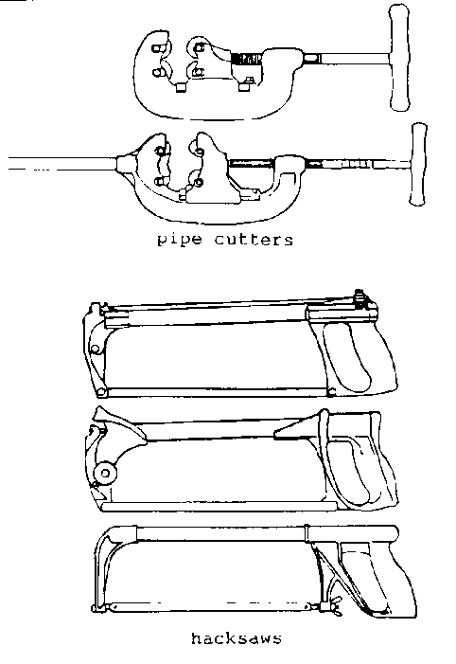
Pumping Systems – Pipes (cont.)
Pipes have to be clamped in order to carry out threading or cutting – chain vices are used
When threading pipe the thread must match that of the fittings or the joint will leak
There are two methods of cutting pipes – pipe cutter or hacksaw

Slide 5
Pumping Systems – Pipes (cont.)
The most common fittings used with galvanised piping are malleable cast iron pipe fittings.
These fittings are used for water, oil, gas, steam or air services.
The maximum working pressures allowed are 140kPa for oil, gas, steam or air.
However, the fittings have a high factor of safety over the specified working pressures.
For higher pressure installations, steel fittings and wrought steel fittings are used

Slide 6
Pumping Systems – Pipes (cont.)
Pipe fittings include:
Bends
Springs
Elbows
T-pieces and Crosses
Reducing elbows
Sockets
Hexagon nipples
Unions
Reducing bushes
Holder bats
Caps
Plugs
Johnson couplings
Backnut
Saddles and Clamps
Swage Fitting
Stoptap

Slide 7
Pumping Systems – Pipes (cont.)
The joints and connections of a piping installation must be sealed to prevent leaking.
There are two types of material used to seal piping connections,:
  PTFE tape
    PTFE tape is white thermoplastic material with a waxy texture in the form of a roll of tape.
    PTFE is an abbreviation for polytetrafluoro-ethylene.
    It is non-flammable and resists chemical reaction.
    It has an electrical resistance and a low co-efficient of friction.
    Used on branch joints
  Hemp rope
    A natural product taken from the fibre of a plant, used to make canvas and rope.
    Used on any other joints than branch joints
These products are wound around the thread of the pipe, onto which a fitting is to be screwed.

Slide 8
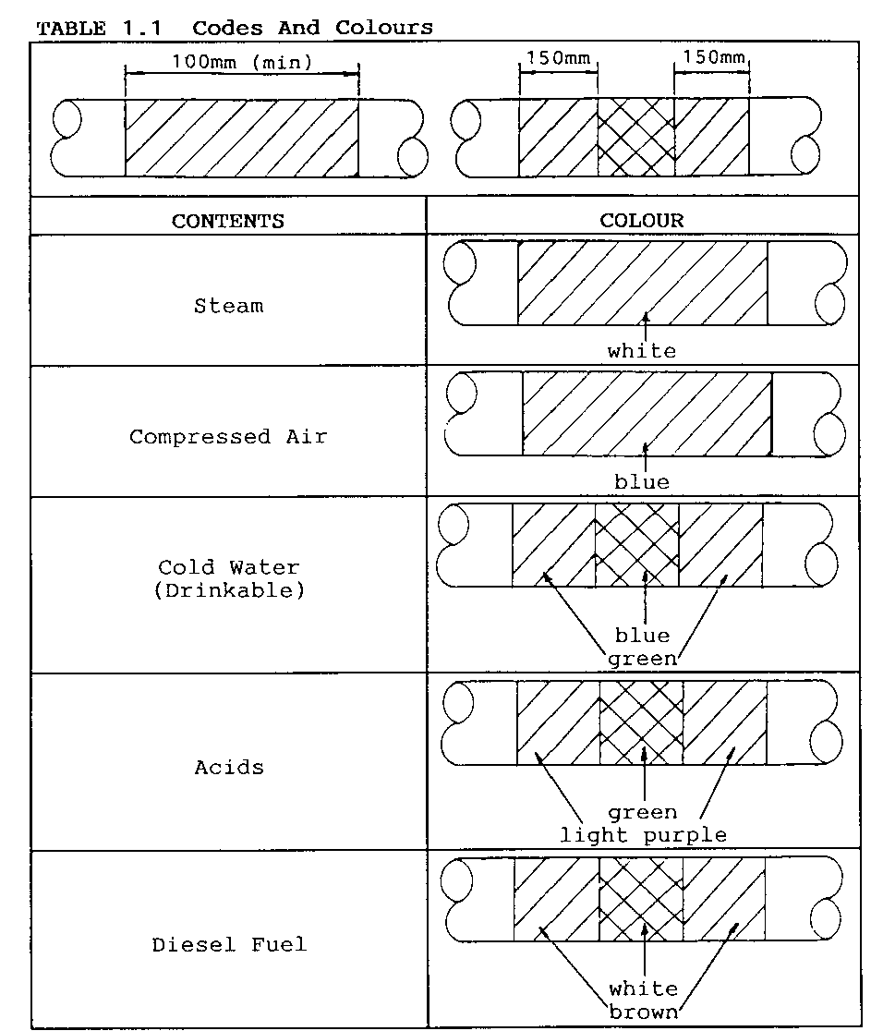
Pumping Systems – Pipes (cont.)
Factories and plants colour code pipes according to the substance flowing through them
This is a safety precaution
It helps the maintenance staff to identify them easily

Slide 9
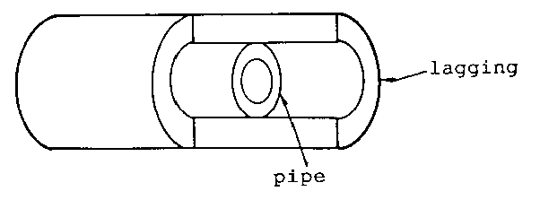
Pumping Systems – Pipes (cont.)
Pipes are lagged or jacketed to prevent the loss of heat or the effect of temperature or oxidation.
If a pipe is lagged, the colour still applies and must be retained if the lagging is removed.
Different materials are used to make pipe lagging, and the type depends on the application.
The lagging may be needed to:
  Insulate at very high or very low temperatures,
  Resist acids, fire, water or wear.
The material used is also dependant on the size of pipes and the space between them.

Slide 10
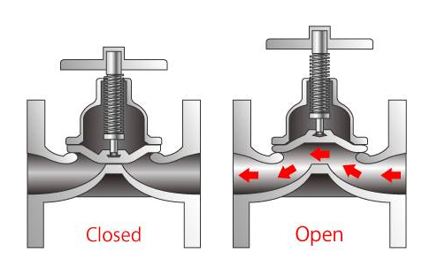
Pumping Systems – Valves
Valves are used to:
  Regulate
  Isolate
  Control, and
  Shut off
  ……….the flow of liquids and gases in a pipe line.
Many different valves available for many different uses.
Valves are manufactured from steel, bronze and non-metallic materials such as Bakelite or other resinous derivatives.
Non–metallic materials are used for valves in systems when an acid is present in the circulated substance.
Valves range in size from 3mm to 100mm for valves with screwed ends and between 50mm and 500mm for vales with flanged ends.

Slide 11
Pumping Systems – Valves (cont.)
Gate valves
Diaphragm valves
Safety relief valves

Slide 12
Pumping Systems – Valves (cont.)
Non-return valves
Globe valves
Butterfly valves

Slide 13
Pumping Systems – Valves (cont.)
Ball valves
Slide valves
Float valves

Slide 14
Pumping Systems – Cleaning and Repair
It is the duty of a maintenance officer to ensure :
  Correct running order of a plant,
  To repair and correct any fault and
  To take action to prevent it from happening again.
All machines have certain parts that are prone to wear and breakages.
All machines must therefore be regularly checked so that such parts can be repaired or replaced before they cause a major breakdown.
Effective maintenance of equipment according to the manufacturer’s instructions to prevent breakdown, is known as routine maintenance.
Issues to be considered when stripping and cleaning include:
  Manufacturer’s instructions
  Sequence of removal of parts
  Dismantling techniques (sketching and proof marking)
  Switching off power
  General safety
  Wear correct PPE’s

Slide 15
Drives – Motors and Turbines
A motor can be defined as “A machine, especially one powered by electricity or internal combustion, that supplies motive power for a vehicle or for another device with moving parts”
A turbine is a device that harnesses the kinetic energy of some fluid such as water, steam, air, or combustion gases and turns this into the rotational motion of the device itself.
  The 4 types of turbines are:
    Water turbines
    Steam turbines
    Gas turbines
    Wind turbines

Slide 16
Drives - Hydraulics
Modern hydraulics is based on a principle formulated by French scientist Blaise Pascal in the 1700’s
Relates to confined fluids transmitting power, multiplying force and modifying motions.
Pressure in a confined fluid is equal at all points in the fluid, and acts in all directions.
Hydraulic fluid is mostly refined oil, and has three main functions in a hydraulic system:
  To transmit power
  To lubricate
  To cool the system

Slide 17
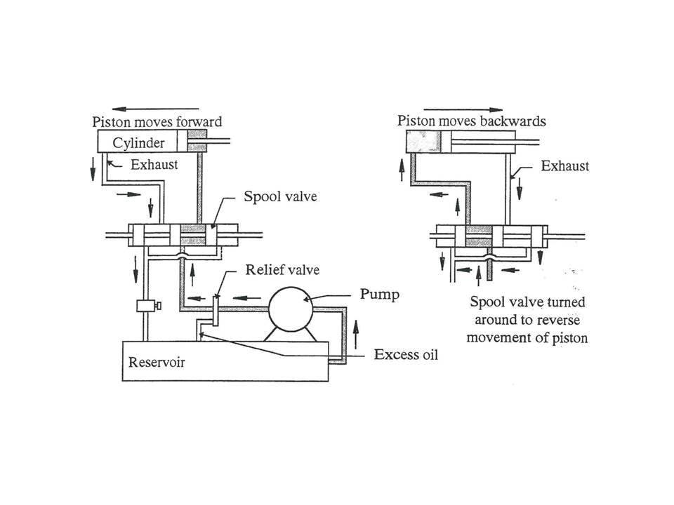
Drives – Hydraulics (cont.)
A simple hydraulic system can operate with the following basic components:
  Reservoir,
  Pump,
  Actuator,
  Pressure relief valve,
  Piping,
  Hydraulic fluid
A hydraulic accumulator is a storage chamber in which fluid energy is accumulated and from which it can be withdrawn.

Slide 18
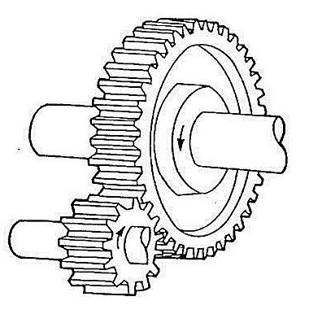
Drives - Gears
A gear can be defined as: “a toothed wheel that works with others to alter the relation between the speed of a driving mechanism (such as the engine of a vehicle) and the speed of the driven parts (the wheels).”
Types of gears include:
  Spur gears
  Helical
  Double
  Worm and wheel
  Bevel
  Rack and pinion

Slide 19
Drives – Gears (cont.)
Spur gears
Helical
Double

Slide 20
Drives – Gears (cont.)
Worm and wheel
Bevel
Rack and pinion

Slide 21
Drives – Gears Drives
Simple gear drives
Compound gear drives
Planetary gear trains

Slide 22
Drives - Clutches
A clutch is a device that allows two components to be engaged or disengaged, whilst one or both of the components is in motion.
When a rotating shaft is connected to a stationary shaft, a clutch must be fitted to turn the stationary shaft and give the option of engaging and disengaging drive power when required.
Clutches as used in motors connected to gearboxes and in assemblies where a driving shaft is connected to a driven shaft.
Types include:
  Positive
  Friction
  Centrifugal
  Hydraulic

Slide 23
Drives – Clutches (cont.)
Function is to transmit torque from a power source (prime mover) directly or via machine parts to the working machine and to provide the possibility to interrupt the transmitted torque.
I.e. Transmit motion from the driving to the driven member by the friction between the engaging surfaces
Are built in many different designs
Driving and driven members of friction clutches are held in engagement by means of spring pressure, although pneumatic pressure, hydraulic pressure and electromagnets may be employed.
Definition:
Torque is any force that causes or tends to cause rotation.
It is the ability of a shaft to cause rotation.

Slide 24
Clutches – Positive-type
Claw clutch
Spiral claw clutch

Slide 25
Clutches – Friction-type
Cone clutch
Plate clutches
Single plate clutch
Multi plate clutch

Slide 26
Clutches – Centrifugal
Spring weighted or spring-controlled centrifugal clutch
Loose weight or free-wheeling centrifugal clutch

Slide 27
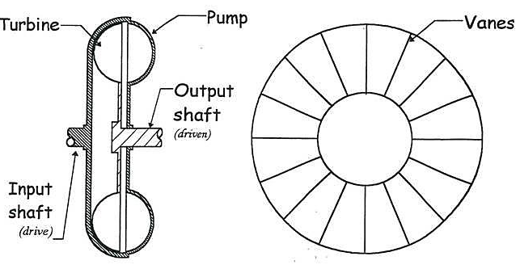
Clutches – Fluid Coupling or Flywheel

Slide 28
Means of operation – Clutches
Mechanical
Torque-limiting
Magnetic-limiting
Hydraulic and pneumatic

Slide 29
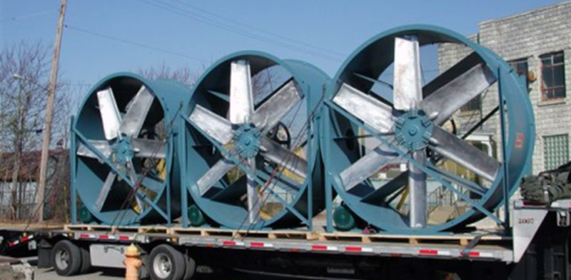
Further equipment found in Sugar Mills
Scales
Fans
Compressors
Pumps
  Vacuum pumps
  Water pumps

