Slide 1
KNOWLEDGE COMPONENT: MODULE 2: SUGAR PROCESSING EQUIPMENT AND TECHNOLOGY: KT4: INTRODUCTION TO PROCESS FLOW AND CONTROL

Slide 2
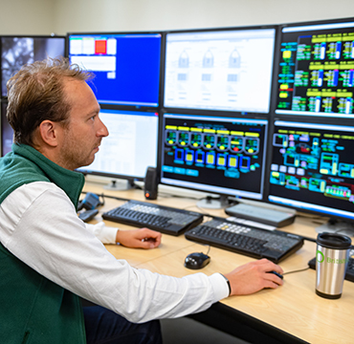
Flow Diagrams
In modern sugar mills and refineries, the entire manufacturing process is monitored and managed, and, to a certain extent controlled, by a Sugar Mill Controller (or Controllers) working on the sugar milling process through computer software in a control room.
Various computer software programmes and computer hardware systems are available for use by the industry.
Each software programme will have a different appearance and the processes described may use different symbols.

Slide 3
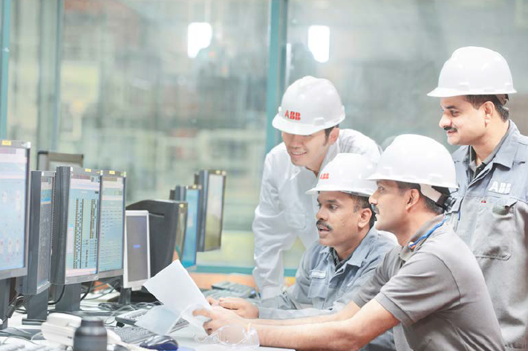
Flow Diagrams (cont.)
It is the software developer’s responsibility to set up these sophisticated systems in a way that suits the Sugar Mill for which it is intended.
How the hardware is connected to, and how it interacts with, the manufacturing process, will also differ from one sugar mill to the next.
It cannot be a “one-size-fits-all” approach, because each Sugar Mill has its own particular way of doing things, and between brands there is also proprietary information where one company’s Intellectual Property or “Trade Secrets” differs from another.

Slide 4
Flow Diagrams (cont.)
Sugar Processing Control Computer software interfaces can be:
  Realistic, stylised or sophisticated
  Schematic and simple
Control systems allow the operator to make immediate decisions about adjustments to processes if there are immediate feed-back mechanisms or control systems connected to the system (providing output volumes or masses, or temperature, pH, pressure, and quality).
A Controller could thus either control or manipulate a process from the control room by:
  Issuing a computer instruction
  Issuing a verbal or written instruction to a Sugar Processing Machine Operator on the factory floor.
Thus, these computer programmes allow Sugar Processing Controllers to monitor the sugar manufacturing process remotely because each step and stage of the sugar manufacturing process is shown on computer screens.

Slide 5
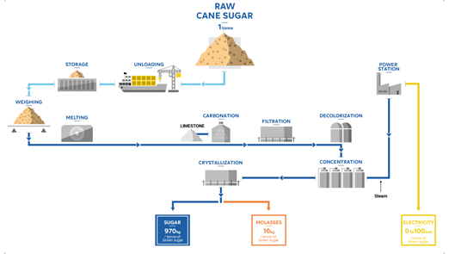
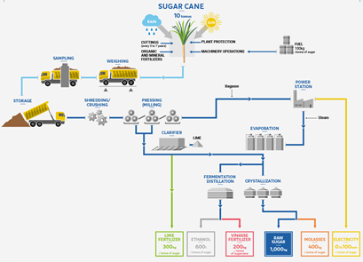
Flow Diagram - Examples

Slide 6
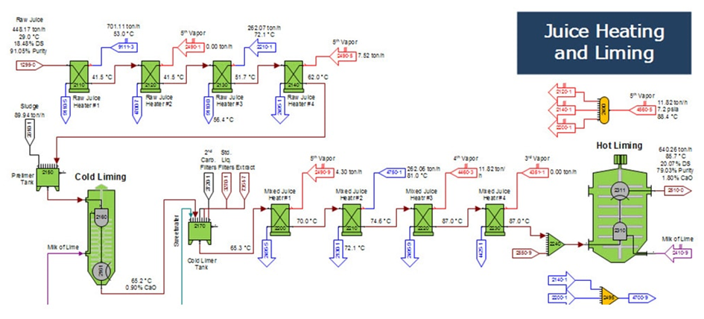
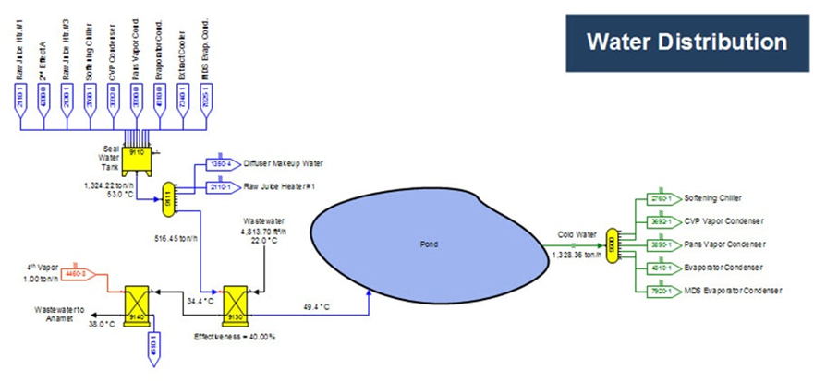
Flow Diagram – Examples (cont.)

Slide 7
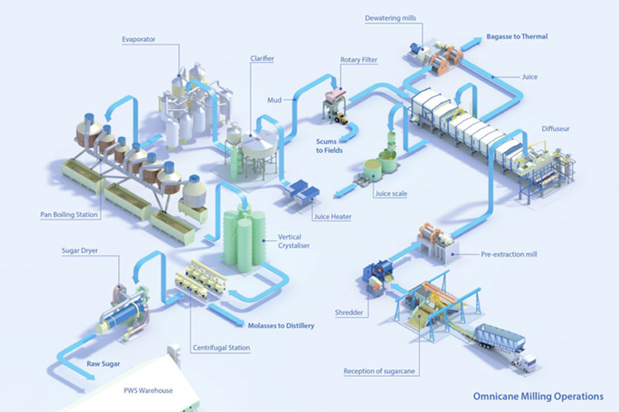
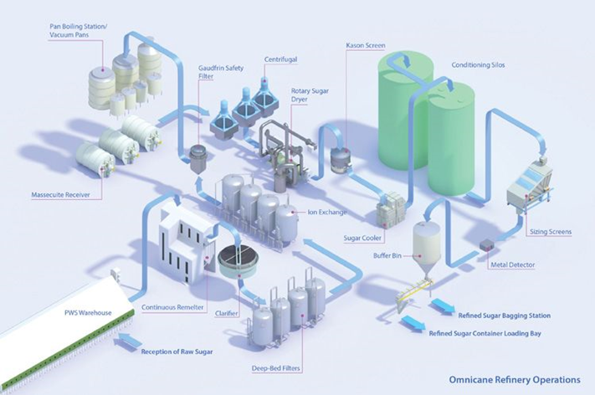
Flow Diagram – Examples (cont.)

Slide 8
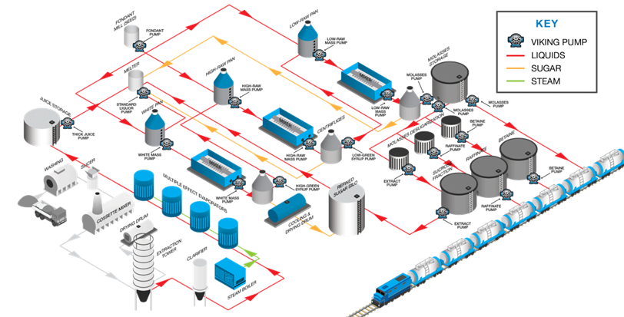
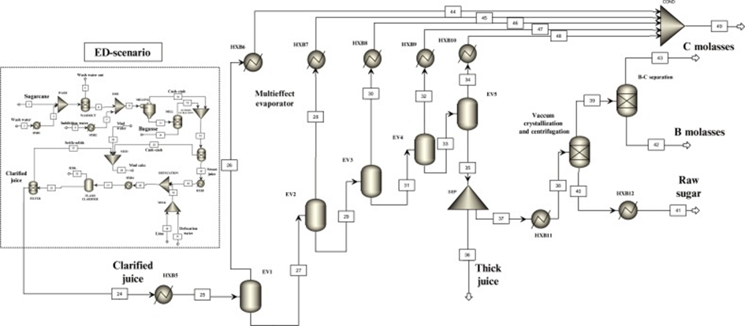
Flow Diagram – Examples (cont.)

Slide 9
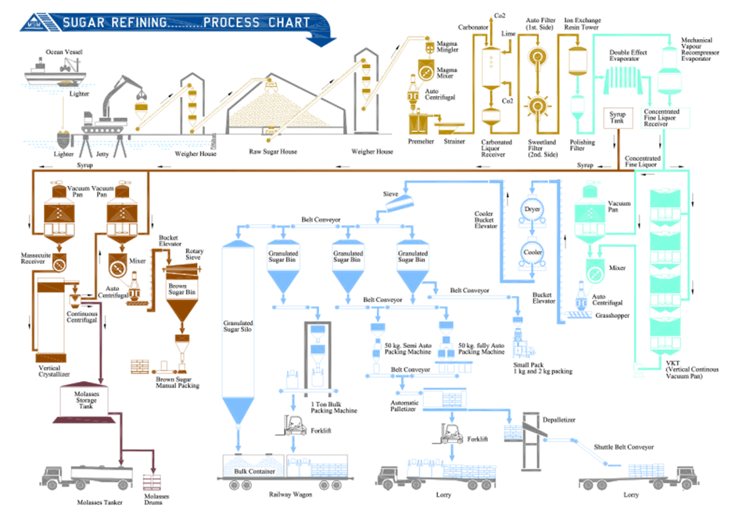
Flow Diagram – Examples (cont.)

Slide 10
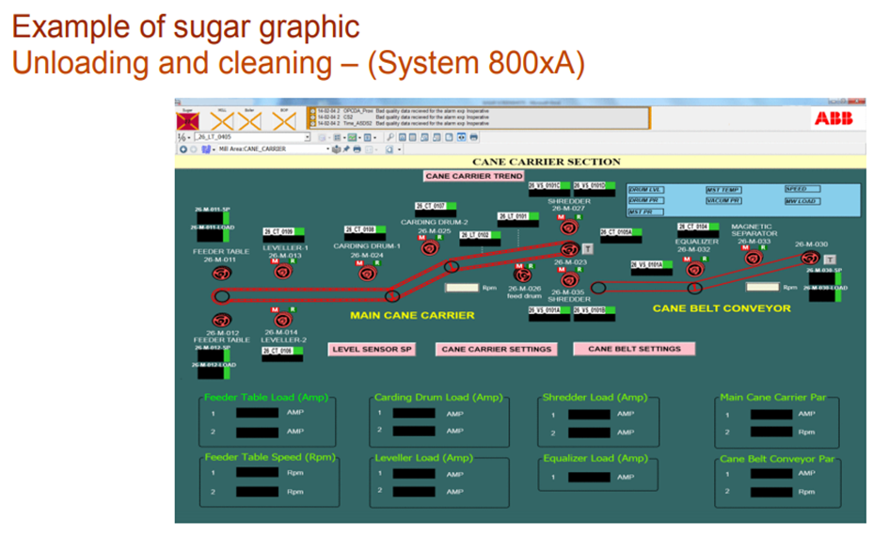
Flow Diagram – Examples (cont.)

Slide 11
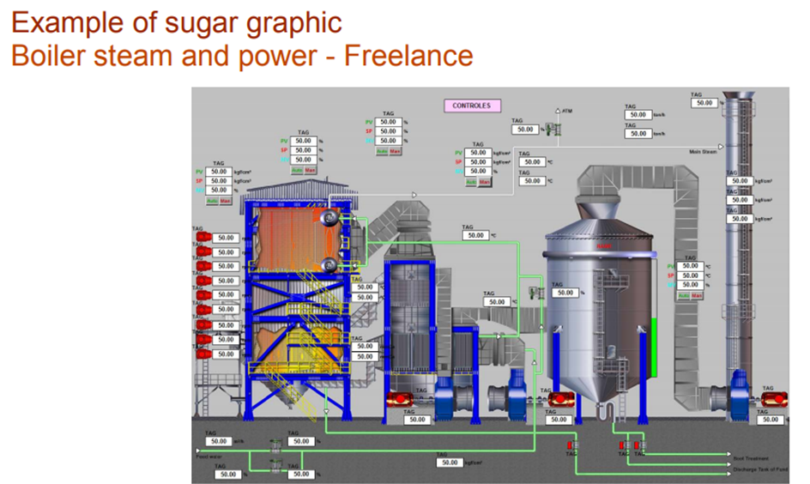
Flow Diagram – Examples (cont.)

Slide 12
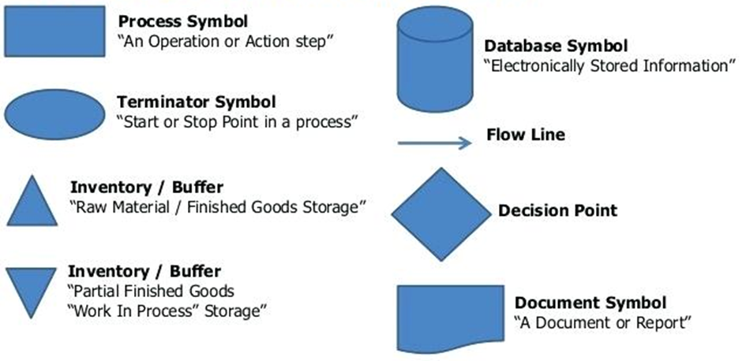
Flow Diagrams – Symbols
Some of the process flow diagrams shown above use realistic images to identify pieces of equipment or processes.
Others use a range of symbols to denote equipment or processes.
These symbols and their meanings will differ from one computer programme to another.
Some examples of the symbols that might be used are shown below.

Slide 13
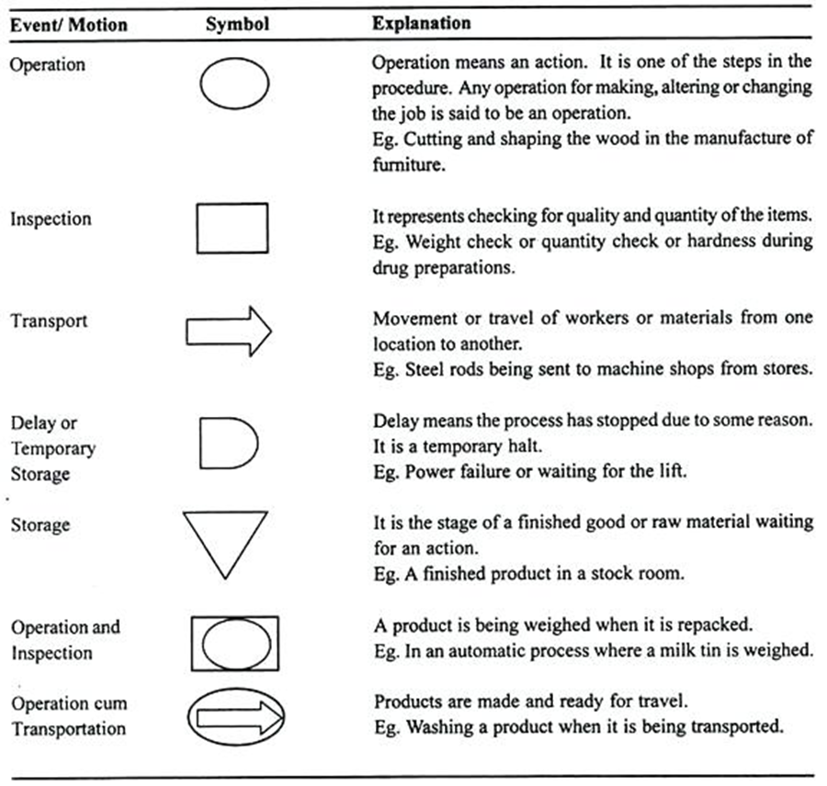
Flow Diagrams – Symbols (cont.)

Slide 14
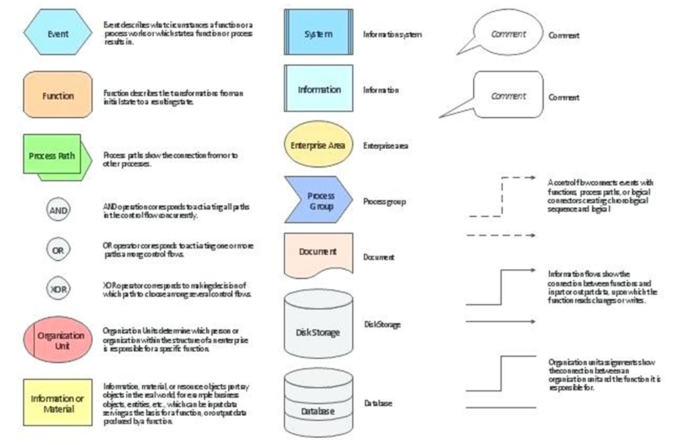
Flow Diagrams – Symbols (cont.)

Slide 15
Instrumentation and Control Systems
Each step of sugar production from cane to sugar is monitored for quality and quantity parameters by sampling and readings of meters, gauges and recorders.
Every operator is constantly monitoring and recording the readings of motors, meters, recorders and gauges at his/her station regularly.
Most modern equipment has instrumentation which monitors these parameters automatically.
Equipment may differ as regards to whether:
  A Sugar Process Machine Operator must adjust the equipment him/herself (based on his/her own monitoring),
  The equipment self-adjusts (based on pre-set performance parameters),
  An instruction must be received from the Sugar Processing Controller in the Control Room (to adjust a setting),
  The Controller can make adjustments remotely.

Slide 16
Instrumentation and Control Systems (cont.)
Samples of bagasse, juices and massecuite are constantly being taken and sent to the laboratory for analysis
Whether the sampling is done automatically, or whether a technician regularly takes the required samples manually, may differ from one factory to the next.
A well-run factory should have records of the quantities of raw materials and processing agents and should check its product losses during the process, as well as the efficiency of the process and equipment.
Daily averages of production and performance figures are entered in a daily report from which a weekly and monthly report is developed.

Slide 17
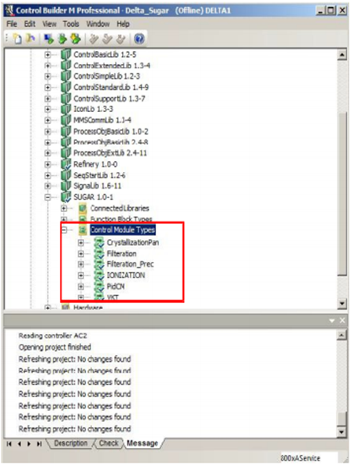
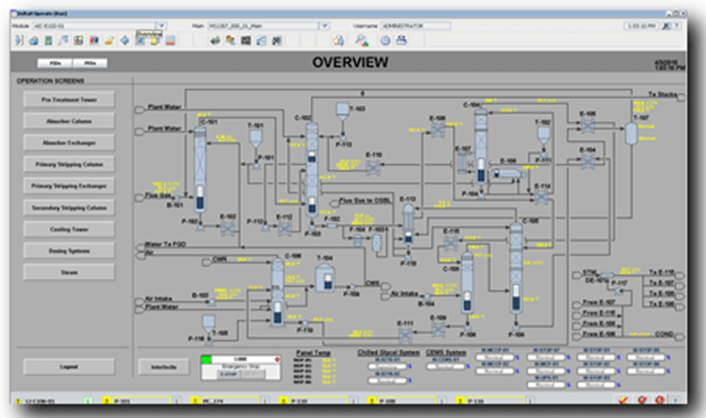
Instrumentation and Control Systems (cont.)
Software programmes will either allow for the automatic uptake of the data from equipment instrumentation, or from manual data input by data capturers or Sugar Processing Controllers.
Computer interfaces for data capture from the processing line, might look something like this:

Slide 18
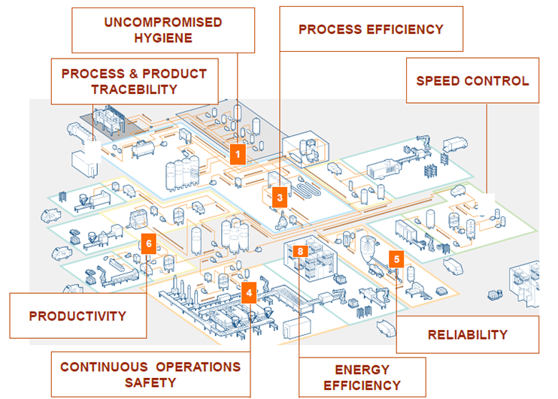
The Goals of Instrumentation and Control Systems

Slide 19
Product Flow and Quality
At each stage of the sugar processing flow different parameters need to be measured and controlled
These stages include:
At the cane preparation stage
At the milling train where juice extraction takes place
During juice clarification
At the evaporators
At the crystallisation and centrifuging stages
At the dryers

Slide 20

Up and Down Stream Communication
Large volumes of data, both from manual and automatic monitoring systems, are collected along the entire processing chain.
These data are converted into information from which:
  Sugar Processing Controllers must make decisions,
  which inform instructions
  that will be given to Sugar Processing Machine Operators
  who must make the necessary adjustments on the factory floor.
It can be understood that a change made in one part of the production process will have implications on other parts of the process flow.

Slide 21
Up and Down Stream Communication (cont.)
Example:
If the sales team informs the refinery that a new order must be shipped as soon as possible….
Will trigger a message to the drying division….
From the packaging department to speed up production if there is not enough product in the storage division…..
This information will be delivered down the process chain….
To where it will create an instruction….
That the conveyor belts bringing the raw sugar cane into the shredders and diffuser need to be speeded up……
Which will have a ripple effect on each of the processes in-between…..

Slide 22
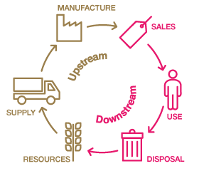
Up and Down Stream Communication (cont.)
Within the factory there will continuously be up-stream (where the raw product comes from) and down-stream (where the final manufactured product ends up) communication along the entire factory production chain.
Modern sugar milling operations even includes decision-making upstream as far back as the actual sugar cane production operations, informing farmers to harvest and transport, or informing them which section of the sugar cane crop should be harvested next.
Such integrated systems use sophisticated satellite imagery that provide much data from which sugar cane producers can make many management decisions.

Slide 23
Up and Down Stream Communication (cont.)
This is a new concept in the agricultural industry and is often referred to as “The Internet of Things” ….. where everything is connected and data flows forwards and backwards, up-stream and down-stream, allowing all parts of the value-chain to work in synchrony.

Slide 24
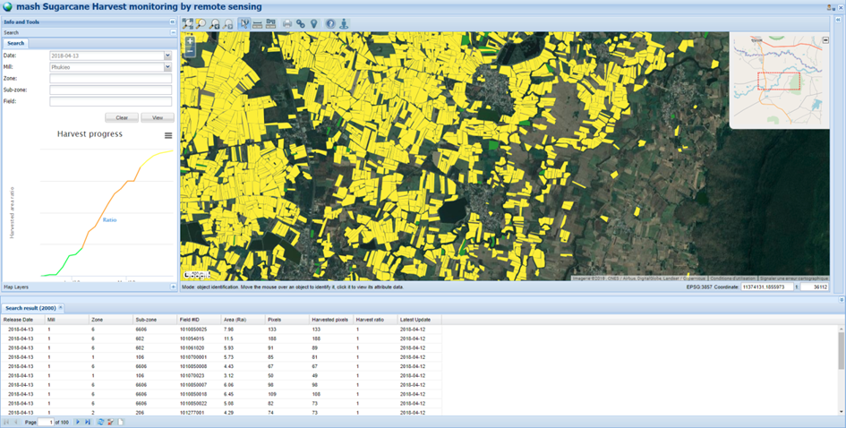
Up and Down Stream Communication (cont.)
The image below shows a screen shot of a satellite imaging software programme showing sugar cane fields.
This programme assists the producer to manage each particular field including decisions related to planting, fertilising, labour allocation, soil fertility parameters, irrigation decisions, harvest readiness and harvesting scheduling.
This may link directly to a similar system (or the same system if it is so integrated) at the sugar mill, so that harvesting and delivery decisions relayed to the producer are informed by the raw material needs of the sugar mill as relayed by the needs to the wholesaler, retailer and consumer.

