Slide 1
KNOWLEDGE COMPONENT: MODULE 2: SUGAR PROCESSING EQUIPMENT AND TECHNOLOGY: KT5: MECHANICAL WORKSHOP PRACTICES

Slide 2
Tools for Lubricating and Cleaning
Lubricating and cleaning tools will each come with their own operating manuals and include:
Grease guns
Grease packer
Grease filler pumps
Grease pumps
Oil levellers
Oil handling containers
Bearing packer
Grease meter
Disposable grease resistant gloves
Grease fitting caps and tags
Broom
Brush
Floor scrubber
Vacuum cleaner
Wash rack
Soap shaker
Mop
Hot water

Slide 3
Mechanical Workshop Safety
The workshop is a dangerous place
Safety rules explain how to dress appropriately and how to behave in the workshop
Only qualified employees are permitted to operate, repair and maintain equipment and machinery
Employees must follow the safety and health rules of the workshop
Each employee should be aware of and avoid unsafe conditions
Each employee should be aware of the regulations applicable to his work environment
Each employee must assist to control or eliminate any hazards in the workshop

Slide 4
Mechanical Workshop Safety (cont.)
Proper clothing – Personal Protective Equipment (PPEs)
You should not wear loose clothes that can be caught in moving machinery.
You should wear overalls that cover your skin, with no outside pockets.
Safety goggles should be worn.
Ties, watches, rings and other jewelry increase the chance of getting caught by moving machinery. You must remove them before entering the workshop.
Long hair should be secured away and preferably be covered.
Protective shoes should be used which will protect your feet from falling objects.

Slide 5

Mechanical Workshop Safety (cont.)
Equipment and Mechanical Safety
Machinery and equipment have moving parts. The action of moving parts may have sufficient force in motion to cause injury to people.
When assessing machinery and equipment for possible mechanical hazards, consider:
  Machinery and equipment with moving parts that can be reached by people
  Machinery and equipment that can eject objects (parts, components, products or waste items) that may strike a person with sufficient force to cause harm
  Machinery and equipment with moving parts that can reach people, such as booms or mechanical appendages (arms)
  Mobile machinery and equipment, such as forklifts, pallet jacks, earthmoving equipment, operated in areas where people may gain access.

Slide 6
Mechanical Workshop Safety (cont.)
Equipment and Mechanical Safety (cont.)
Common mechanical hazards and associated risks for machinery and equipment are shown below.
Hazard | Risk
Rotating shafts, pullies, sprockets and gears | Entanglement
Hard surfaces moving together | Crushing
Scissor or shear action | Severing
Sharp edge – moving or stationary | Cutting or puncturing
Cable or hose connections | Slips, trips and falls (e.g. oil leaks)

Slide 7
Mechanical Workshop Safety (cont.)
Non-Mechanical Hazards
Non-mechanical hazards associated with machinery and equipment can include:
  Harmful emissions,
  Contained fluids or gas under pressure,
  Chemicals and chemical by-products,
  Electricity and noise,
All of these hazards can cause serious injury if not adequately controlled.
In some cases, people exposed to these hazards may not show signs of injury or illness for years.
Where people are at risk of injury due to harmful emissions from machinery and equipment, the emissions should be controlled at their source.

Slide 8
Mechanical Workshop Safety (cont.)
Unsafe Conditions
Faulty equipment such as machines, engines, pumps, vehicles, electrical apparatus and hand tools that could cause injury, and which in general, could have been corrected, create unsafe conditions.
Examples of unsafe conditions include:
  Machines with unguarded pulleys, gears or other dangerous moving parts.
  Slippery floors.
  Sharp objects.
  Unsafe storage.
  Poor lighting.
  Improper ventilation.
  Noise.
If you see any hazardous conditions whilst doing your job, be sure to report it to your supervisor who will see that it is made safe.

Slide 9

Mechanical Workshop Safety (cont.)
Unsafe Acts
An unsafe act is that violation of a commonly accepted safety rule, which is sure to cause an accident or incident.
Unsafe acts account for more than 80% of accidents and incidents.
Examples are:
  Operating vehicles, tools or equipment without the necessary permission.
  Working at unsafe speeds.
  Making safety devices inoperative, or by removing machine guards.
  Unsafe loading of vehicles.
  Cleaning, adjusting or oiling moving machinery.
  Failing to use personal protective equipment such as goggles, gloves, safety shoes, etc.
Most accidents CAN be prevented if everybody adheres to safety rules and takes care when the situation demands it.

Slide 10
Mechanical Workshop Safety (cont.)
Basic Electrical Safety
Electricity must be respected.
A variety of electrical equipment is present in sugar plants
Only qualified, certified electricians should install and maintain electrical equipment.
Electrical equipment includes motors, controls, tools and lighting.
Employees without proper training and supervision by a knowledgeable person should not attempt to perform any electrical work.

Slide 11
Mechanical Workshop Safety (cont.)
Basic Electrical Safety (cont.)
Report broken or defective electrical equipment to their employer immediately; for example, broken conduits, exposed electrical conductors, missing covers or bolts in controls, and improper electrical equipment.
Reset a circuit breaker only once; if it trips a second time, consult a qualified electrician to determine the cause of the overload.
Do not bypass fuses; if a fuse blows, replace it with a fuse of the same (proper) size.

Slide 12
Mechanical Workshop Safety (cont.)
Basic Electrical Safety (cont.)
Do not use metal ladders around electrical equipment; use only nonconductive ladders, such as wood or fiberglass.
Ground all electrical equipment and systems properly.
Do not run extension cords under rugs, across walkways, through walls, etc.
Use extension cords rated for the service required.

Slide 13
Mechanical Workshop Safety (cont.)
Basic Electrical Safety (cont.)
Extension cords should be inspected before use for nicks cuts or breaks in the insulation; the ground prong on the extension cord should never be removed.
Electrical tools may provide a source of ignition and should not be used in ignitable or explosive atmospheres.
Electrical tools should be inspected before use for cracks in the housing or cord. Double-insulated electrical tools are preferred.

Slide 14
Mechanical Workshop Safety (cont.)
Basic Electrical Safety (cont.)
If you are wet or standing in water, never touch any electrical equipment.
Do not overload electrical circuits.
Stay away from power lines. Pay particular attention to moving equipment that may contact these lines. Remember that these lines are not insulated and current may arc to equipment that comes in close proximity to them.
Label electrical circuits and fuses to indicate the equipment they control.

Slide 15
Basic Engineering Symbols
Engineering drawings, electrical instructions and tool instruction manuals all use different symbols to denote universal concepts within each field.
The charts below provide some of these symbols within these fields.
Ensure that you understand the meanings of the symbols related to the document you are referring to.

Slide 16
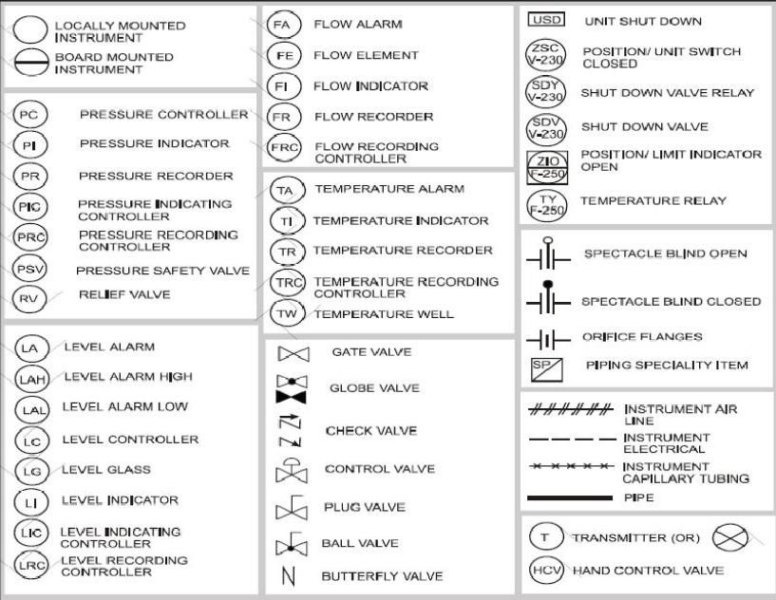
Basic Engineering Symbols (cont.)
Instrumentation Diagram Symbols

Slide 17
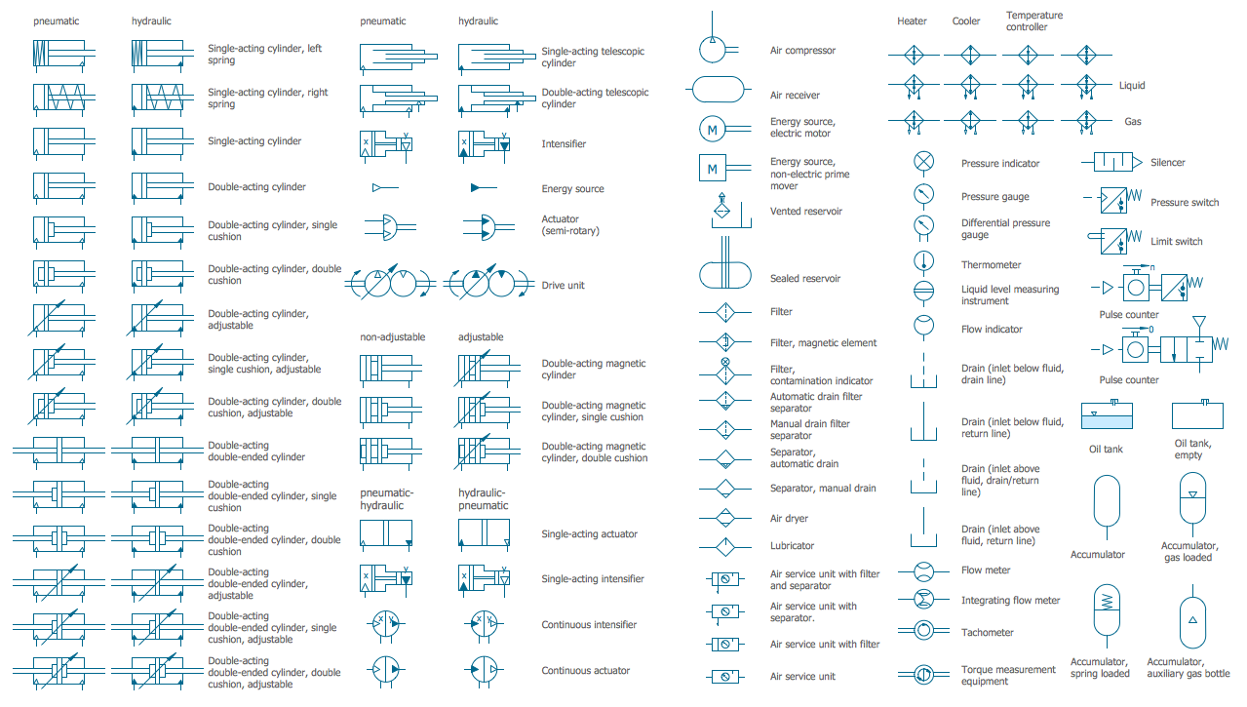
Basic Engineering Symbols (cont.)
Mechanical Drawing Symbols

Slide 18
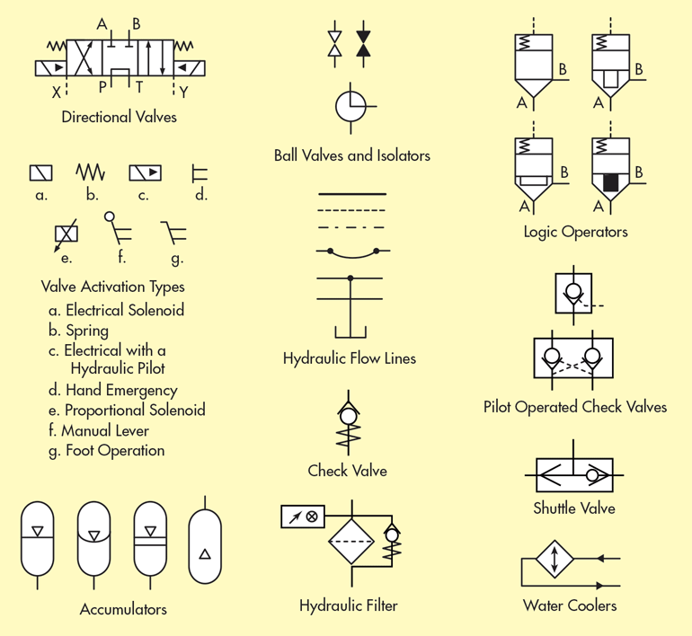
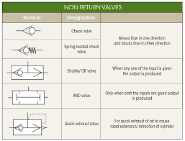
Basic Engineering Symbols (cont.)
Hydraulic Circuit Symbols

Slide 19
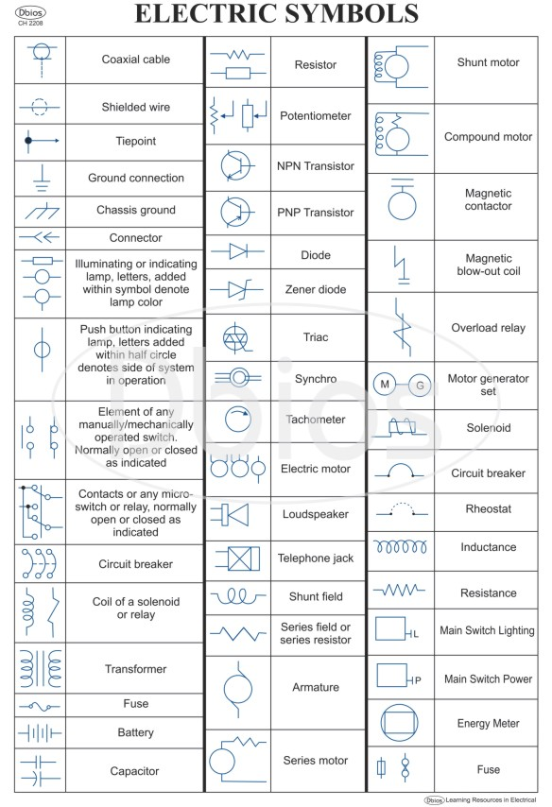
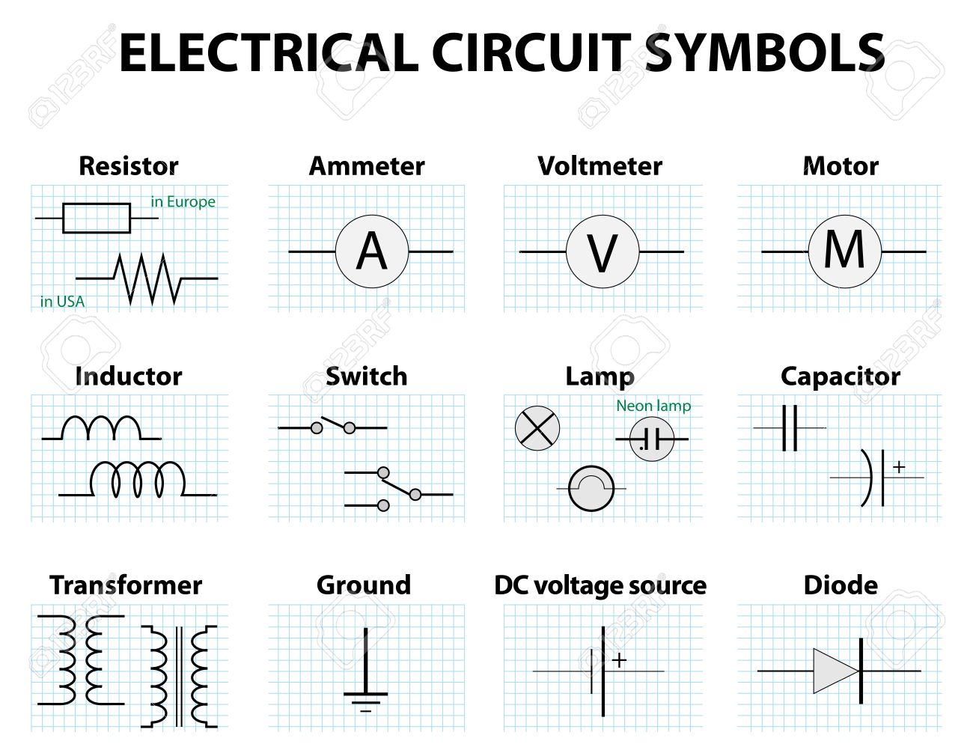
Basic Engineering Symbols (cont.)

Slide 20
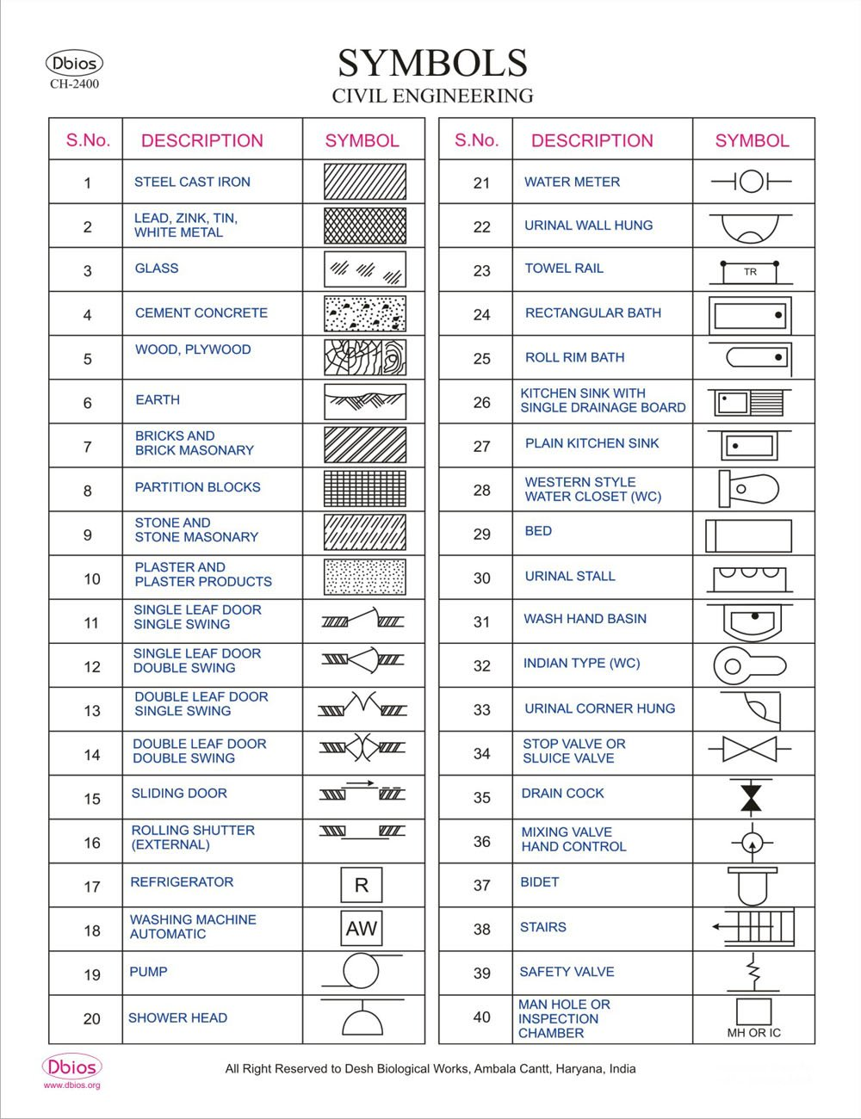
Basic Engineering Symbols (cont.)

Slide 21
Use of Equipment Manuals
It is always advisable to follow manufacturer’s instructions to understand the operations of a piece of equipment.
Manufacturer instructions provide you with the technical information that you require to help you assess the level of risk associated with that piece of equipment.
This information then assists you to decide:
  What PPE to wear,
  What environmental conditions should be adhered to and
  What would be considered an unsafe practice.
Manufacturer’s instructions explain:
  What the equipment is used for,
  What the technical information regarding the piece of equipment is, and
  How to maintain that piece of equipment.

Slide 22
Use of Equipment Manuals (cont.)
An example of a Manufacturer’s Instruction manual is provided.
Looking at this manual you will see it contains some of the following sections:
  A key to symbols used in the manual
  Technical drawings showing the parts of the equipment (and what each part is called)
  General safety precautions
  Particular warnings and important considerations
  Assembly instructions
  How to lubricate, refuel, sharpen, tighten etc.
  How to start and stop the machine / equipment

Slide 23
Use of Equipment Manuals (cont.)
Manufacturer’s Instruction sections (cont.):
How to operate the equipment – What to do before, during and after operation – What NOT to do
Environmental factors that may influence operation of the equipment (e.g. Must be used in a well-ventilated area, Not to be used near an open flame, etc.)
Maintenance requirements, instructions and recommended maintenance schedules
Technical data (e.g. weight, power use, noise emissions, etc.)
Troubleshooting guidelines
Manufacturer’s contact details
Warranty details

Slide 24
Lubricants
Whenever any part or object moves against another part or object, friction will occur, turning kinetic energy into heat and causing equipment to wear.
Using lubricants helps to reduce this friction
Less friction allows more work to be done for the same amount of energy input
Less friction lowers temperatures of the materials in contact
Less friction greatly extends the lifespan of the moving parts.

Slide 25
Lubricants (cont.)
There are several different types of lubricants available for commercial use
Each lubricant is suited to particular applications and circumstances.
They can be broadly classified into three lubricant types:
  Liquids,
  Semi-solids, and
  Solids.

Slide 26
Lubricants - Liquids
Liquid lubricants are generally referred to as oils
Share the properties of all liquids
  Are able to flow, and
  Take the shape of their containers.
Are tested for many different properties that determine how they will function over a range of conditions and environments.
Some of the most important include:
  Lubricity
  Viscosity
  Viscosity Index
  Cloud Point
  Pour Point
  Oxidation and Corrosion
  Flash, Fire, and Auto-ignition Points

Slide 27
Lubricants – Semi-Solids
Semi-solid lubricants are typically referred to as greases,
Share many of the same properties of their liquid counterparts, but are designed:
  To stay in one place or
  Stick to the parts they are meant to lubricate.
Greases can be classified using hardness.
The hardness is based on the overall composition of all parts that make up the grease, which includes:
  Fluid base,
  Thickener,
  Additives, and
  Fillers

Slide 28
Lubricants – Solids
Solid lubricants are solid materials, which reduce the coefficient of friction and wear of rubbing parts preventing direct contact between their surfaces even under high loads.
Forms of lubricants: Solid lubricants may be present in the friction area in the form of either dispersed particles or surface films:
  Coating (film) of a solid lubricant applied on the part surface.
  Composite coating consisting of particles of a solid lubricant dispersed throughout a matrix.
  Particles of a solid lubricant dispersed throughout the bulk of the part material (composite material).
  Powder of a solid lubricant delivered to the rubbing area (dry lubrication).
  Additives in lubricating oils or greases.

Slide 29
Lubricants – Solids (cont.)
Required properties of solid lubricants:
  Low shear strength in the sliding direction. This property provides a low coefficient of friction due to easy shear movement of the lubricant material.
  High compression strength in the direction of the load (perpendicular to the sliding direction). A solid lubricant possessing high compression strength is capable of withstanding high loads without causing direct contact between the rubbing surfaces.
  Good adhesion of the solid lubricant to the substrate surface. This property ensures the presence of the solid lubricant on the part surface even at high shear stresses.
The best combination of the first two properties are possessed by anisotropic materials like graphite, molybdenum sulphide or boron nitride having a lamellar crystal structure.

Slide 30
Lubricants – Solids (cont.)
Advantages of solid lubricants:
  Ability to work under high loads.
  High thermal stability.
  Diversity of the application methods.
Disadvantages of solid lubricants:
  Higher coefficient of friction and wear than the liquid types of lubricants.
  Low stability of the lubrication film.
  Less convenient system of lubricant delivery to the friction surfaces. In contrast to solid lubricants fluid lubricants are continuously supplied, filtered and cooled.

Slide 31
Lubricants – Solids (cont.)
Classification of solid lubricants
  Inorganic lubricants with lamellar structure
  Oxides
  Soft metals
  Organic lubricants with chain structure of the polymeric molecules
  Soaps
Lubrication could fail because of:
  Over lubrication
  Under lubrication

Slide 32
Fasteners and Locking Devices
Mechanical Locking Devices
Mechanical locking devices (e.g., split washers, nylon nuts) were invented to solve the common problem of loosening that occurs in most threaded assemblies.
Although they were made for this purpose, they have several shortcomings.
  Loosen under vibration, thermal expansion and/or improper torque
  Do not seal threads
  Require extensive inventory of several shapes and sizes
  Prone to rust

Slide 33
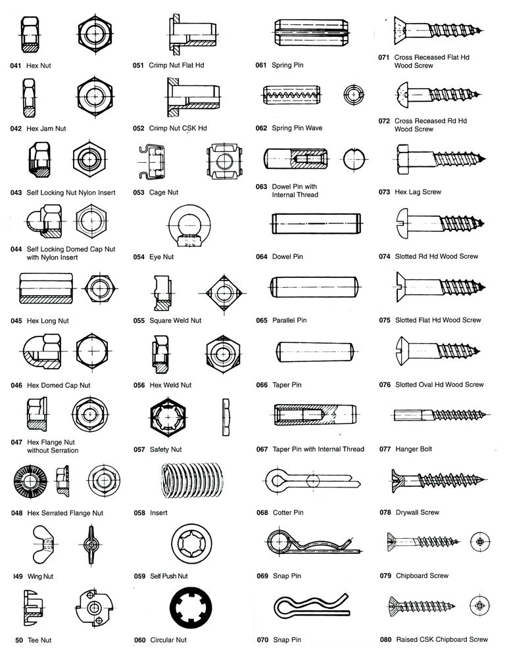
Fasteners and Locking Devices (cont.)

