Slide 1
KNOWLEDGE COMPONENT: MODULE 3: BASIC BUSINESS STUDIES: KT2: PRODUCTIVITY AND PRODUCTIVITY IMPROVEMENT

Slide 2
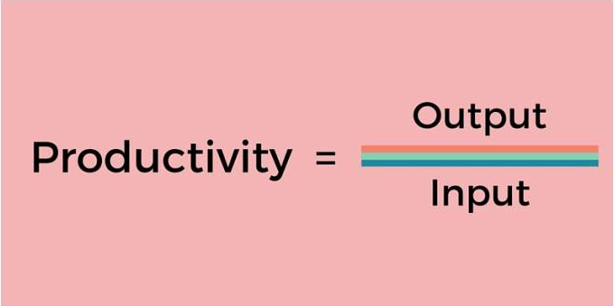
Productivity Measures
Productivity is the ratio of total outputs per total inputs used in the production of goods or services
Methods to measure productivity include:
Management by objectives
Measuring productivity quantitatively (products per employee, or per week, or per year)
Feedback mechanisms (co-workers score each other)
Service industries may measure:
Number of tasks completed
Speed of delivery
Customer feedback
Self-evaluations
Time management productivity
Productivity by Profits
Quality of tasks completed

Slide 3
Productivity Measures (cont.)
Productivity of a Sugar Mill employee could be measured on:
How long it takes for a process to be completed.
How many batches an employee completes per day/week/month.
How many times re-work has been necessary.
Whether there has been accident incidents by the employee in a certain time period (or number of accident-free days)
How often products from the employees’ processes are below quality.
Whether there are complaints from the employees’ supervisor or co-workers regarding the work or conduct of the employee.

Slide 4
Continuous Improvement
A continual/continuous improvement process can be abbreviated as CIP or CI
Ongoing effort to improve products, services, or processes.
Seek "incremental" improvement over time or "breakthrough" improvement all at once.
A practice of constantly re-examining and improving processes.
Not something that you “do.” Rather, it’s a way a company operates.
Adopting continuous improvement in a company means two things:
Focus on Growth – The company should have an ongoing focus on incrementally improving their processes, services or products. Perfecting the way you do things “on-the-go” instead of carrying out one-off change initiatives.
Creating a Culture of Improvement – More often than not, it’s the employee on the shop floor who’s an expert on company processes. Continuous improvement should be the responsibility of everyone in the company.

Slide 5
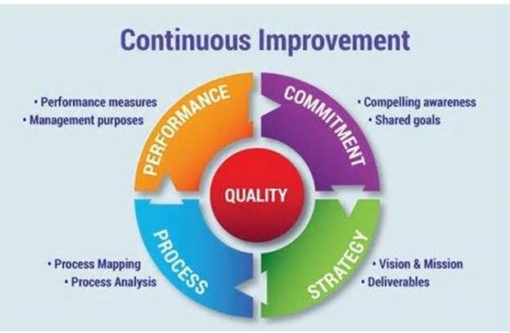
Continuous Improvement (cont.)

Slide 6
Continuous Improvement (cont.)
Benefits of Continuous Improvement include:
Increased productivity and profits
Increased output per unit input
Greater efficiency
Improved employee morale and accountability
Employees contribute ideas and feel appreciated
Every employee is key to organisational growth
Makes employee feel valued

Slide 7
Profitability and Productivity
Productivity is defined as the relationship between output and input needed to create a product.
Meanwhile, profitability is determined by how much money is left over after a product is produced and all expenses have been paid.
Productivity in the workplace relates to how efficiently your workers accomplish your company's goals and produce goods or services for customers.
If productivity increases, more outputs are produced from less inputs, thus expenses are reduced per unit of output

Slide 8
Ways to improve Productivity
Be efficient
Delegate
Reduce distractions
Have the right tools and equipment
Improve workplace conditions
Offer support and set realistic goals
Practice positive reinforcement
Ensure employees are happy

Slide 9
Ways to improve Profitability
Prepare a strategic plan
Determine up to five key success factors for your business
Implement and monitor a budget
Benchmark revenue and overhead percentages with your industry
Develop a cost accounting system
Conduct internal and external client satisfaction surveys regularly

