Slide 1
KNOWLEDGE COMPONENT: MODULE 4: QUALITY ASSURANCE: KT1: BACKGROUND AND QUALITY CONTROL AND ASSURANCE

Slide 2
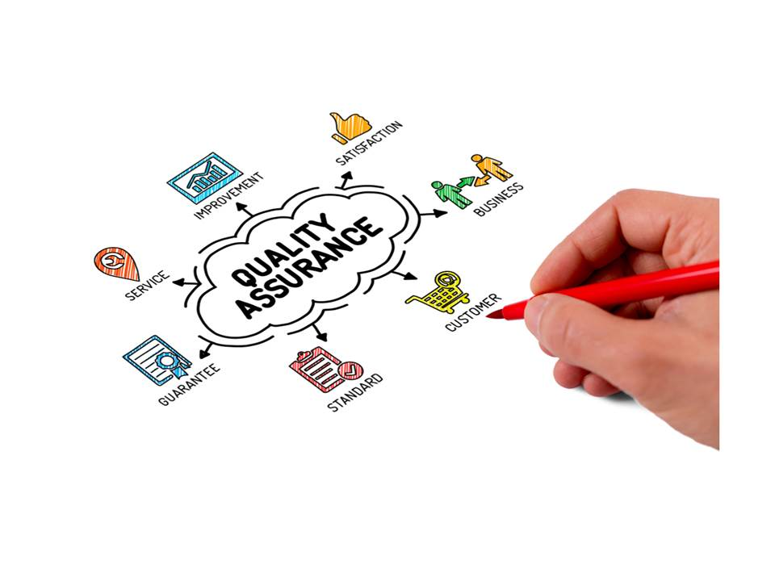
Background
Consumers have exacting standards
Quality management systems enable Sugar Mills to measure and control the extraction, clarification, and crystallization of a premium quality, low colour sugar.
QMS enables the sugar mill to maintain the desired standard of the final product
The system to monitor parameters throughout the manufacturing process.
Parameters to be measured (and adjusted constantly) include:
Time
Temperature
Concentration
pH
Purity
Helps prevent mistakes and defects
A pro-active process

Slide 3
Quality Management Systems
A formalised SYSTEM that documents
What is documented?
Processes
Procedures
Responsibilities
A PROCESS set in place for achieving quality objectives
Helps co-ordinate and direct the activities needed to:
Meet customer standards
Meet regulatory requirements
Improve effectiveness
Improve efficiency
Helps to ensure safe, quality food
ISO 9001 is the standard describing the documents detailing the QMS

Slide 4
Quality Management Systems (cont.)
Quality management systems serve many purposes, including:
Improving processes
Reducing waste
Lowering costs
Facilitating and identifying training opportunities
Engaging staff
Setting organization-wide direction

Slide 5
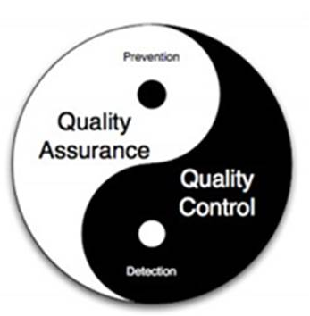
Quality Control and Assurance
A set of activities for ensuring quality in the processes by which products are developed (manufactured)
The goal of QA is:
To improve development and test processes
To prevent defects during manufacture
Thus:
Quality Assurance
Process oriented
Defect prevention
Quality Control
Product oriented
Defect identification

Slide 6
Quality Assurance
A set of activities
Pro-active process
Aims to PREVENT defects
Concentrates on the process used to make the product
Helps improve manufacturing processes
A QMS system is established, then assessed for its adequacy
Everyone in the manufacturing process is involved

Slide 7
Quality Assurance (cont.)
Recognised QA systems in the food industry include:
GMPs (Good Manufacturing Practices)
GHPs (Good Hygiene Practices)
GAPs (Good Agricultural Practices)
GLPs (Good Laboratory Practices)
HACCP (Hazard Analysis Critical Control Point)

Slide 8
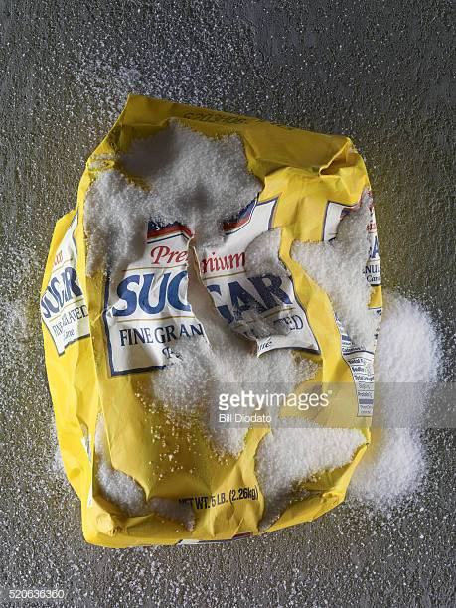
Quality Control
A set of activities
Ensures quality in products
Identifies defects in the finished product produced
Identifies and eliminates sources of quality problems
Products are tested for defects
Involves inspection

Slide 9
Quality Indicators and Specifications
Define the quality of a product
Tangible measurements (weight, colour, moisture content etc.)
Intangible elements (smell, taste etc.)

Slide 10
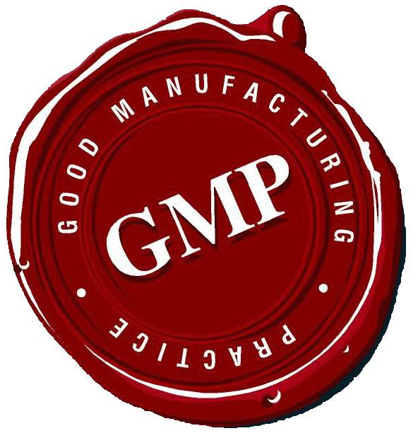
Good Manufacturing Practices
Originally developed for pharmaceutical companies
Adapted for food production
Aims to ensure foods that are:
Free of extraneous matter
Glass
Machine filings
Insect parts
Hygienic
Basically GOOD HOUSEKEEPING
Assures product specifications

Slide 11
Good Manufacturing Practices (cont.)
Product specifications can be:
Regulatory
Commercial (consumer preference)
In-house (brand quality)
Ensures things are done right, the first time and every time
Helps re-design the process to eliminate future errors
Covers:
Employee training
Plant design
Equipment specifications
Cleaning
Sanitation
Quality Assurance

Slide 12
Good Manufacturing Practices (cont.)
Not a regulation but forms part of the Food, Disinfectants and Cosmetics Act of 1972
GMP is part of a QMS such as ISO
GMP is practical
Can be tailored to a factory’s specific needs
Concerned with HOW things are done
Builds safety and quality into the product
Most cost effective way to minimize defects
A set of controls that ensure attainment of quality targets

Slide 13
Good Manufacturing Practices (cont.)
For a food processing operation minimum controls are required for:
Personnel hygiene
Cleaning and sanitation
Waste management
Pest management
Management of foreign objects, chemicals and microorganisms
Planned maintenance.

Slide 14

Good Manufacturing Practices (cont.)
The aim of sugar processing is:
To remove impurities present in the cane
The production of pure white, or good raw, sugar
The aim of GMP is:
To ensure that no unnecessary, additional foreign materials are introduced into the final product
Foreign materials previously found in final sugar include:
Bagacillo ….
Dust….
Micro-organisms….
Welding globules, glass fragments, spider webs, bird feathers, animal and plant fibres, paper, rodent faeces, insects, lubricating oil, cigarette butts, matches………

Slide 15
Good Manufacturing Practices (cont.)
Aside from satisfying expectations of customers, implementing GMP:
Reduces waste
Improves cost and production control
Reduces re-work
Improves staff motivation
Improves staff performance and efficiency
Five elements involved in implementation:
Commitment and policy
Planning
Implementation
Monitoring and verification
Review and improvement

Slide 16
GMP Implementation
Commitment and Policy
Management must be convinced that GMP is needed
Need to be committed
Must be willing to provide resources for its implementation
A policy must be put in place, starting at the current status quo (where they are now)
GMP policy must form part of overall business plan and mission, vision, core values and beliefs, and takes into account the image that the company wants to project
The commitment can be communicated in posters, incentive schemes, announcements, notices, media etc.
A senior person should be assigned to its implementation
A steering committee can be set up to guide the implementation

Slide 17
GMP Implementation (cont.)
Planning
Appoint a champion
Set up a task force to investigate:
What needs to be achieved
Perform a preliminary review (Where are we now?). May include:
Interviewing key personnel
Assessing the state of different operations and their quality parameters
Assessing which aspects of the operation affect the quality of the final product
Benchmarking against industry, legal or international standards
Assessing existing information systems on maintenance and inventory control
Draft a preliminary strategy with prioritised objectives and targets and the management system to meet these

Slide 18
GMP Implementation (cont.)
Planning (cont.)
Make an estimate of resources required. Will probably include:
Cost of training
Training needs
Cost of consulting
Materials
A database for information management
Assign responsibilities
Task force should be:
Knowledgeable about the technical aspects of the business
Have experience in operations
Have experience in auditing
Sent for training if not knowledgeable

Slide 19
GMP Implementation (cont.)
Planning (cont.)
Examples of objectives for a cane sugar factory may include:
Minimise leaks from pipes, pumps, flanges and seals
Reduce bagacillo and dust levels in the crystalliser and drier sections of the factory
Minimise air draughts by which micro-organisms can be introduced to the production areas
Minimise spillages of sugar
Minimise damage to finished product
Minimise the presence of birds, rodents and insects in the packing station and warehouse.

Slide 20
GMP Implementation (cont.)
Planning (cont.)
Examples of measurable targets with time schedules or limits for a cane sugar factory may include:
There will be no bottles, cans, sandwiches or cigarette butts in the work area
Dust filters to sugar driers will be cleaned once a day during the morning shift
The target for re-work of sugar from damaged packets will be less than X tons per month
Rodent bait stations will be checked once a week and results recorded in a designated file.

Slide 21
GMP Implementation (cont.)
Implementation
Aspects to be addressed by a GMP system in a cane sugar factory include:
Damaged packets in the warehouse must be minimised
Sugar dust must be eliminated in the packing station and transfer points
A policy on personnel hygiene must be drawn up and enforced
A planned maintenance system to reduce juice leaks must be implemented
Air currents into the factory must be eliminated
Pipe lagging needs to be inspected regularly to ensure that lagging material does not enter product streams
Formalised cleaning schedules must be drawn up
Steps to keep lubricants out of the process stream must be put in place
A policy on the control of glass is necessary
A policy on waste management is necessary

Slide 22
GMP Implementation (cont.)
Implementation (cont.)
Each aspect is dealt with by a 3-tiered methodology:
Company policy
Procedures (Standard Operating Procedures)
Work instructions and forms
Assign responsibilities for the development of these to key people. They need:
Experience in the operation
Good communication skills
To work with the workers in their areas to develop solutions to each problem
To develop schedules, procedures and checks
To provide estimates of resource requirements or equipment modifications that need to be made

Slide 23
GMP Implementation (cont.)
Implementation (cont.)
A GMP Policy manual needs to be developed which will contain:
Policy
Objectives and targets
Detailed procedures
Work instructions and forms
Copies of manuals given to key people
Procedure must be established for updates and modifications
Implement a system to:
Track budget
Keep financial controls
Record measurable benefits

Slide 24
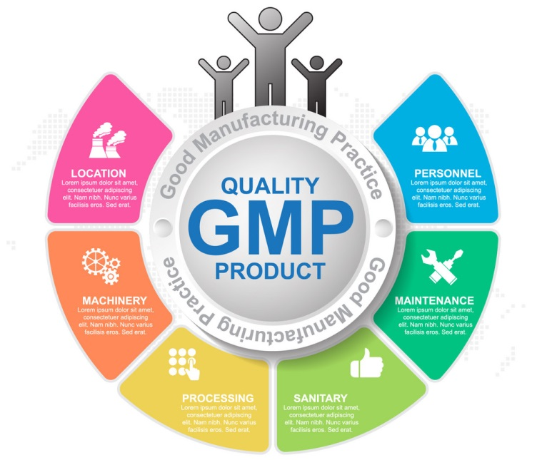
GMP Implementation (cont.)
Monitoring and verification
Monitoring involves checking that the procedures are being carried out and achieving objectives
Feedback must be documented on:
Problems encountered
Suggested solutions
Don’t collect useless data
Corrective action must be implemented asap
Modification of procedures must be documented and incorporated into manual

Slide 25
GMP Implementation (cont.)
Review and Improvement
Scheduled self-inspections should be carried out
Periodic inspections by a 3rd party may be required (for accreditation to a Quality Standard like ISO)
Inspections may identify quality improvement projects (which again need to be planned, implemented and monitored)
A cycle of improvement is thus set in motion
Thorough reporting after the audits and formalised procedures for dealing with the audit findings are necessary

Slide 26
Key Control Points
Hazard Analysis Critical Control Point (HACCP) is a system that identifies and monitors:
Specific food-borne
Biological
Chemical
Physical properties
That negatively affect the safety of a food product
Specific points along the food processing chain are identified which are particularly vulnerable to contamination (potential hazards)
These more likely points are then monitored

Slide 27
Key Control Points (cont.)
The seven principles of HACCP are:
Analyze hazards
Identify critical control points
Establish preventative measures with critical limits for each control point
Establish procedures to monitor the critical control points
Establish corrective actions to be taken when monitoring shows that a critical limit has not been met
Establish procedures to verify that the system is working properly
Establish effective record-keeping to document the HACCP system

Slide 28
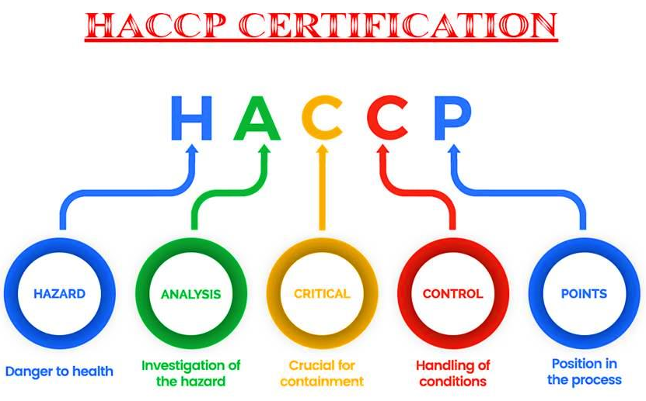
Key Control Points (cont.)

Slide 29
Key Control Points (cont.)
Definition of HACCP terms:
Cleaning means washing with water of adequate sanitary quality.
Control means to prevent, eliminate, or eradicate.
Control measure means any action or activity that is used to prevent, reduce to acceptable levels, or eliminate a hazard.
Critical control point (CCP) means a point, step, or procedure in a food process at which a control measure can be applied and at which control is essential to prevent, reduce to an acceptable level, or eliminate an identified food hazard.

Slide 30
Key Control Points (cont.)
Definition of HACCP terms (cont.):
Critical limit means the maximum or minimum value to which a physical, biological or chemical parameter must be controlled at a critical control point to prevent, eliminate, or reduce to an acceptable level the occurrence of the identified hazard.
Food hazard means any biological, chemical, or physical agent that is reasonably likely to cause illness or injury in the absence of its control.
Hazard Analysis and Critical Control Points (HACCP) means a systematic approach to the identification, evaluation, and control of food safety hazards.

Slide 31
Key Control Points (cont.)
Definition of HACCP terms (cont.):
HACCP Plan means the written document that is based upon the principles of HACCP and delineates the procedures to be followed.
HACCP Team means the group of people who are responsible for developing, implementing, and maintaining the HACCP system.
Hazard Analysis means the process of collecting and evaluating information on hazards associated with the food under consideration to decide which are significant and must be addressed in the HACCP plan.

Slide 32
Key Control Points (cont.)
Definition of HACCP terms (cont.):
Juice means the aqueous liquid expressed or extracted from the cane.
Juice concentrate means the aqueous liquid extracted from the cane and reduced in volume through the removal of water from the juice.
Monitor means to conduct a planned sequence of observations or measurements to assess whether a process, point or procedure is under control and to produce an accurate record for future use in verification.

Slide 33
Key Control Points (cont.)
Definition of HACCP terms (cont.):
Process Authority means an expert in the processes for controlling pathogenic microorganisms in food, and, as such, is qualified by training and experience to evaluate all of the aspects of your pathogen control measures, e.g. process time, temperature, type of equipment, etc. and determine that your measures, if properly implemented, will control pathogens effectively.
Shelf stable product means a product that is hermetic ally sealed and when stored at room temperature, should not demonstrate any microbial growth.

Slide 34
Key Control Points (cont.)
Definition of HACCP terms (cont.):
Validation means that element of verification focused on collecting and evaluating scientific and technical information to determine whether the HACCP system, when properly implemented, will control effectively the identified food hazards.
Verification means those activities, other than monitoring, that establish the validity of the HACCP plan and that the system is operating according to the plan. It includes validation procedures.

Slide 35
Quality Reports
A quality report is a report which documents a specific quality process or outcome
Examples include:
An inspection test plan
Quality communications plan
Non-conformance report
Reports should include:
Changes in quality from a previous measurement
Maintenance of a quality standard over time
The quality measured in relation to industry norms
The methods used to the collect the data should be presented
An analysis of the data – not just the collected data
Recommendations from reports should be implemented
Records need to be kept for a period of time determined by the industry

Slide 36
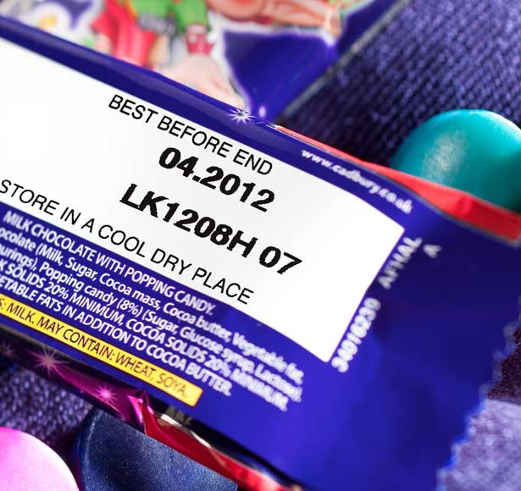
Traceability
The ability to track food through all stages of production, processing and distribution
Should also extend backwards to enable identification of the source of all raw materials
Benefits:
Increases supply chain visibility
Improves quality control systems
Reduces risk
Allows suppliers to respond quickly to any safety or quality issues
Allows product recall if products present a threat to the public

Slide 37
Traceability (cont.)
Suppliers are able to determine the source of the problem
Can tell distributors to remove the product from the shelves
Protects the supplier from legal action
Protects the consumer from a potentially dangerous product
Can also be used to prove certain attributes such as:
Country of origin
Ethical credentials (e.g. FairTrade)

Slide 38
Traceability (cont.)
Issues forming part of a traceability system include:
Identification: Identification of the products and standardization of information and of the parts which influence the quality of a product.
Link: The management throughout the supply chain among the lots and logistic units.
Registry: The data and the information recorded throughout the production and logistic process.
Communication: The greater the association and alignment of the information along the supply chain, the greater will be the capability of management to respond to quality issues.

Slide 39
Traceability (cont.)
In order for the traceability system to be really effective it is necessary for the entire sugar processing process to be properly identified and documented, in such a way that allows access to each stage of its history throughout production
The various paths that the product takes and the changes that the product may suffer along the way until its final consumption must be known
Some information about the production process needs to be carefully measured and followed (monitored), as well as integrated into a proper information system

