Slide 1
KNOWLEDGE COMPONENT: MODULE 4: QUALITY ASSURANCE: KT3: PRINCIPLES OF FOOD SAFETY AND QUALITY ASSURANCE

Slide 2
HACCP
Hazard Analysis Critical Control Point
A systematic preventative approach
Aims to eliminate biological, chemical and physical hazards from a product
Hazards are identified
Points along the production line at which the hazards are most likely to occur are identified
Sampling and analysis or assessment is set up at those points
Continuous monitoring and improvement

Slide 3
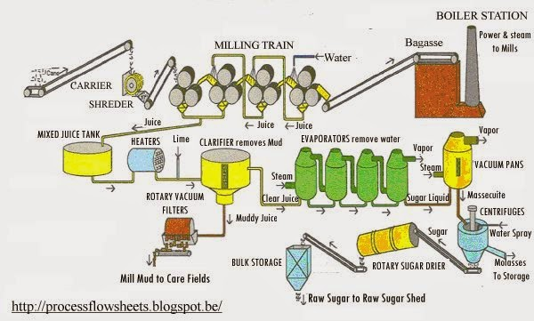
HACCP in Sugar Processing
Step 1: Draw up a process flow diagram From raw material too final product

Slide 4
HACCP in Sugar Processing (cont.)
Identify Critical Control Points (CCP’s)
Identify parameters that require monitoring along the production line
In sugar processing, these are the most likely CCPs:
CCP 1: Sugarcane growing
CCP 2: Sugar extraction
CCP 3: Crystallisation and Centrifugation
CCP 4: Drying and Cooling of sugar
CCP 5: Sugar storage
CCP 6: Packaging
CCP 7: Transportation

Slide 5
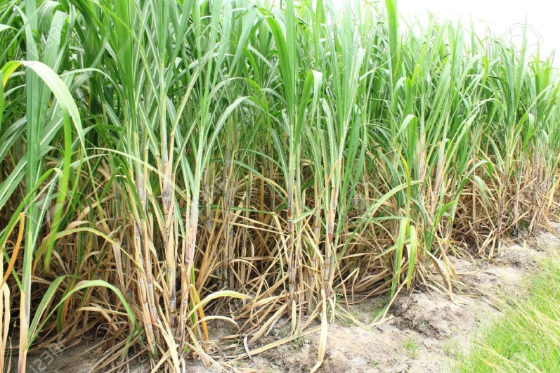
CCP 1: Sugar Cane Growing
Sources of contamination could include:
Commercial fertilisers
Sewerage sludge
Heavy metals (from the above)
Herbicides
Insecticides
Fungicides
These must be used according to suppliers guidelines

Slide 6
CCP 2: Sugar Extraction
Contamination by micro-organisms from cane fields (soil)
Temperature, pH, water activity and sugar content favour microbial growth
Microbial activity causes sucrose degradation
Microbial activity leads to formation of reducing sugars
Results in formation of organic acids and exopolysaccharides
Causes slime which clogs pipes and filters
Formation of lactic acid causes corrosion of steel

Slide 7
CCP 2: Sugar Extraction (cont.)
Microbial flora include:
Mesophiles (Lactobacillus and Leuconostoc)
Thermophiles (Bacillus stearothermophilus, B. pumilus, Clostridium)
Chemical control may include:
Formalin (40% aqueous solution of formaldehyde)
Ammonium compounds
Dithiocarbamates
Sulphur dioxide
Saponins (glycosides of hydrophobic alcohols) lead to foamy solutions
Anti-foaming agents are used
Excessive use may lead to residues in molasses and bagasse

Slide 8
CCP 3: Crystallisation and Centrifugation
Thick juice from the evaporators is low in micro-organisms
However, crystallisation and centrifugation are susceptible to microbial contamination
High humidity and temperatures in sugar refinery causes sugar dust and syrup to settle as a thin film on walls, floors and pipes
This favours microbial growth and generates a source of contamination
Good housekeeping and hygiene precautions must be implemented

Slide 9
CCP 3: Crystallisation and Centrifugation (cont.)
Good housekeeping and hygiene precautions include:
Improved air circulation (or extraction)
Temperature regulation
General cleanliness
Tanks and pipes should be covered, monitored, cleaned and sterilised using approve cleaning agents and disinfectants
Filters can remove 90% of the bacteria present in juices
Heating to 90°C should destroy micro-organisms
Crucial stage of processing - downgraded sugar at this stage cannot be reworked
Most microbes are removed with syrup by centrifugal force in centrifugation process unless…

Slide 10
CCP 3: Crystallisation and Centrifugation (cont.)
Unless…sugar conglomerates have formed in which microbes are trapped (Conglomerates must thus be avoided)
Wash water is a further source of contamination – thus must be sterilised and filtered
Consider every surface or material that comes into contact with the final product
Equipment should be constructed of materials that minimise any risk of contamination
Stainless steel is preferred

Slide 11
CCP 4: Drying and Cooling of Sugar
Airborne microbial contamination is a concern at this point
Sugar dust is a suitable carrier of mould spores
Moist sugar crusts can form on conveying devices
Condensed sugar water can form on ceilings which can drop onto equipment or product stream
Sanitary measures and hygienic standards must be implemented
Cleaning with appropriate disinfectants is essential
Conveyors can be enclosed

Slide 12
CCP 4: Drying and Cooling of Sugar (cont.)
Air filters can be installed to reduce dust
Foreign bodies such as metals, glass and plaster from walls and ceilings are concerns at this point
Metal detectors and X-rays can be used to screen final product
Equipment (conveyors, drum dryers, screens) must be constructed of materials that will minimise contamination

Slide 13
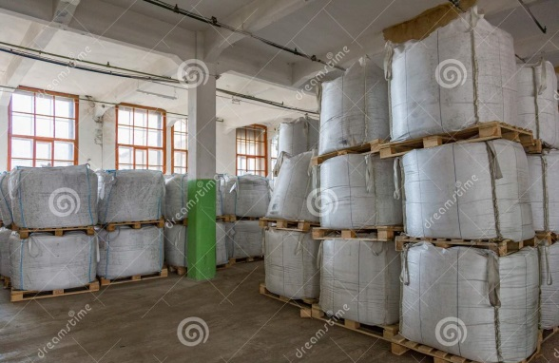
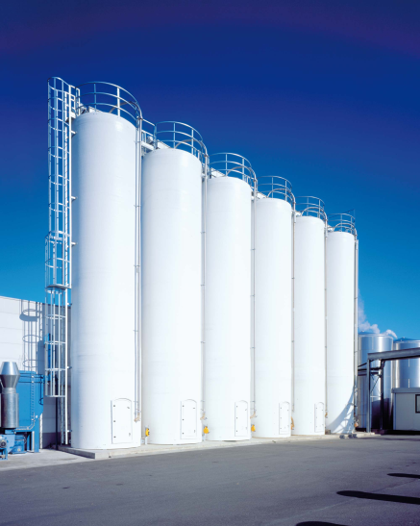
CCP 5: Sugar Storage
Sugar is stored in large sacks in storehouses
Sugar can become hard and caked, or wet
Ventilation is important
Packing height is a concern
Temperature and humidity conditions must be monitored
Sugar is stored as bulk in silos
High temperatures and humidity above 60% causes sugar crystal agglomeration
High level of hygiene is required
No other product may be stored in the sugar silo or storehouse
Silo air conditioners must be filtered

Slide 14
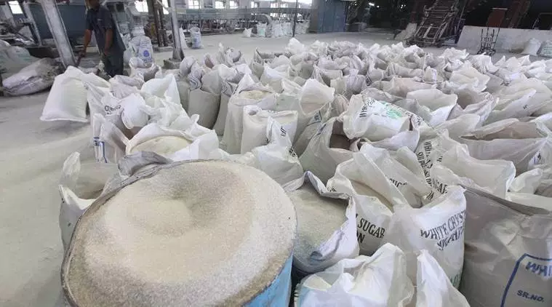
CCP 6: Packaging
Sugar is packaged in multi-wall paper sacks
Hazards introduced can be:
Microbiological (from packing material, equipment or personnel)
Physical
Chemical
High level of food and personnel hygiene is required
Surfaces must be constantly monitored and cleaned

Slide 15
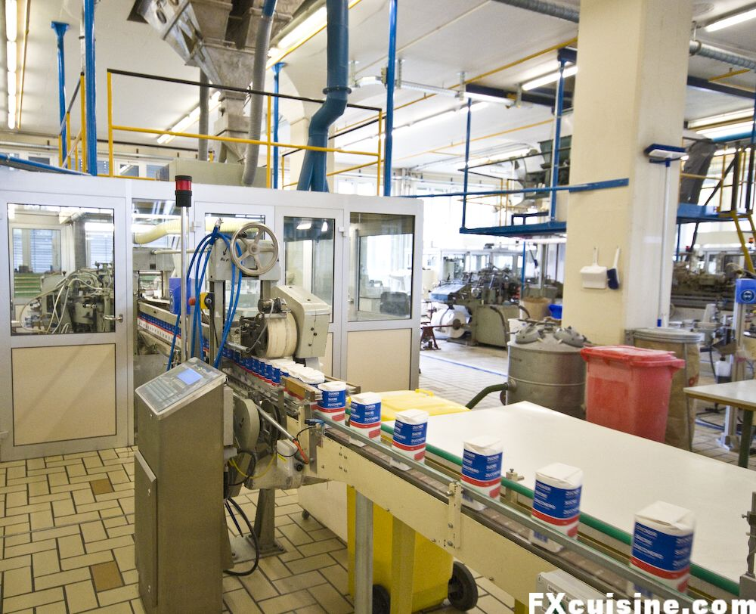
CCP 6: Packaging (cont.)
Air filters for dust collection
Storage area of the packaging materials must be sanitary and hygienic
Physical hazards from foreign materials can be eliminated using metal detectors or X-rays
Chemical hazards are often introduced by the packaging. These include:
Heavy metals
Paraffin components
Dyes
Chlorinated organic compounds
Paper sacks should be:
Approved for food packaging
Purchased from official suppliers
Consignments should be adequately packaged

Slide 16
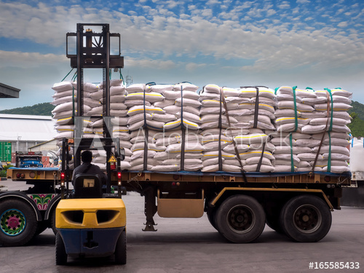
CCP 7: Transportation
Transportation carried out by:
Tanker vehicles (bulk)
Covered trucks (packaged sugar)
Trucks should:
Only be used for food transportation
Inspected for chemical remains
Inspected for presence of foreign materials
Inspected for water (source of microbial contamination)
Bulk sugar is loaded into tanker vehicles through flexible pipes:
Pipes must be constructed of approved materials suitable for contact with foods
Pipe connections must be hygienic

Slide 17
HACCP in Sugar - Conclusion
The sugar industry is considered one of the safest industries in terms of occurring incidents or outbreaks caused by its products!
Implementation of HACCP in the sugar industry is the reason for this
Critical control points illuminates the range of the most crucial parameters that need attention:
Moisture
Heavy metals
Pesticides
Herbicides
Extraneous materials
Acceptable limits are prescribed by industry norms and legislation
HACCP helps to improve hygiene of personnel as well as factory
HACCP works well in conjunction with a Total Quality Management system such as ISO or GMP

Slide 18
Personal Hygiene
Personal health and hygiene practices are good for:
The overall image and productivity of the company (the company becomes well-known for its safe product and workers are healthy and take less leave),
It is good for the individual worker (the worker is a healthier individual), and
The health of his family and community (the worker does not transmit diseases to the people around him).
Basic concept of cleaning, grooming and caring for our bodies so that we remain healthy
Important for worker health and safety
Paying attention to personal hygiene:
Prevents spread of micro-organisms and disease
Reduces exposure to chemicals and contaminants
Avoids skins allergies, conditions and chemical sensitivities

Slide 19
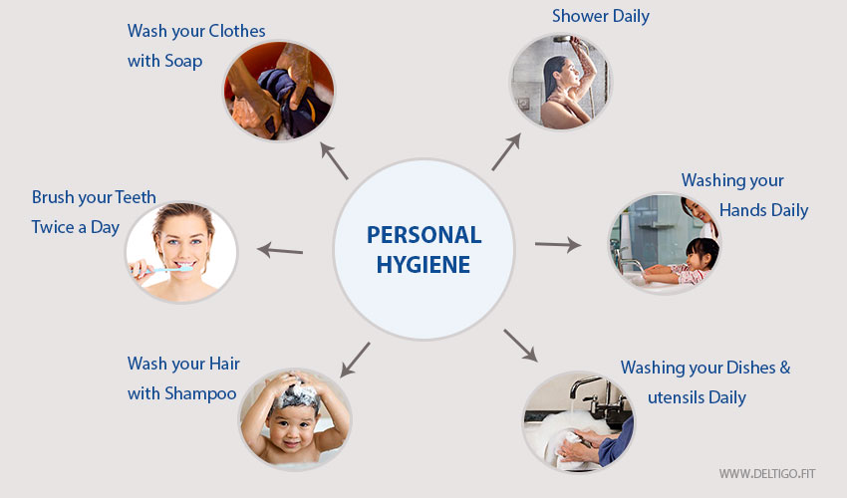
Personal Hygiene

Slide 20
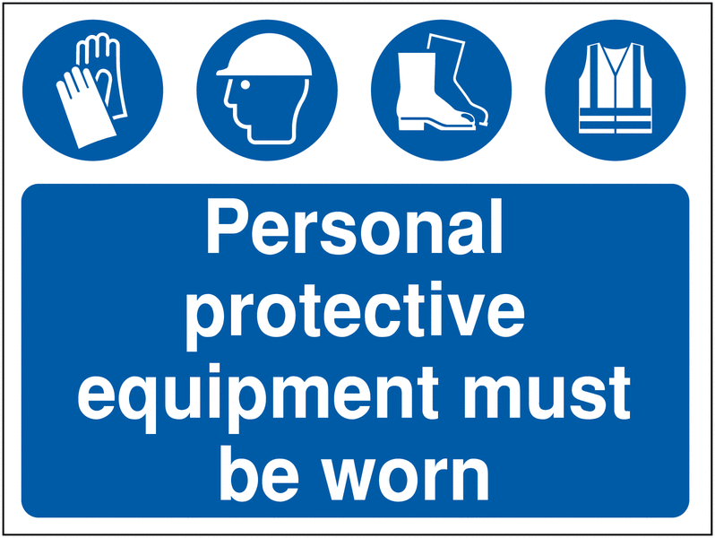
Personal Protective Equipment
First line of defense is to avoid exposure to hazardous substances
PPE’s form a barrier over the skin
PPE’s include gloves, overall, boots
PPE’s should be regularly checked for contamination, wear, tears, cuts or holes
Clean, decontaminate and replace PPE’s frequently
If PPE’s become too soiled during work-time, the worker should stop and replace it with clean PPE’s

Slide 21
Personal Protective Equipment (cont.)
Sugar factory workers should wear PPE’s that:
Are clean
Are washable
Are light-coloured
Are without external pockets (to avoid snagging on moving equipment)
Are suitable for the work being carried out
Cover ordinary clothes completely

Slide 22
Personal Protective Equipment (cont.)
Ordinary clothing carry contaminants such as dust, pet hairs and woolen fibres
Personal clothes and belongings should not be brought into the factory (store in personal lockers)
All personnel and visitors must wear PPE’s that comply with company standards.

Slide 23
Personal Protective Equipment (cont.)
The following PPE must be worn at all times:
Overalls: To protect your body from products and spillages.
Safety boots/gum boots: To protect your feet from falling objects.
Hair nets or restraints

Slide 24

Personal Hygiene Practices
Hands
Wash hands regularly throughout the day
Dry with disposable paper towels
All those working in a sugar factory must wash their hands
At the beginning of a shift.
Before handling any equipment.
After lunch and tea breaks.
After handling product and before they handle other product.
Immediately after going to the toilet, blowing their nose, coughing, sneezing, smoking, eating, combing or touching their hair, handling waste product or rubbish and handling cleaning equipment.

Slide 25

Personal Hygiene Practices (cont.)
Hands (cont.)
Basic hand washing and skin care can prevent work exposures and disease.
Good washing and scrubbing with water and soap helps to remove bacteria, contaminants, and chemicals.
It can also prevent exposure by ingestion and cross-contamination of the surfaces and objects we touch.
To wash hands properly:
Wet hands under the faucet
Then use liquid or bar soap
Hold hands out of the water until all skin surfaces are scrubbed and lathered for at least twenty seconds
Then rinse with clean water
Dry hands with a disposable towel.

Slide 26
Personal Hygiene Practices (cont.)
Hands (cont.)
To wash hands with a hand sanitizer:
Apply the appropriate amount of sanitizer into the palm of the hand
Rub hands together until they are dry being careful to cover all surfaces of the hands
Please note: For some job activities, hand sanitizers are not an acceptable means of hand cleaning.
Showering and face-washing after work is also a good idea.

Slide 27

Personal Hygiene Practices (cont.)
Cuts and Sores
Cuts and sores can provide an ideal place for bacterial growth.
To prevent contamination of product by harmful bacteria and blood, these wounds must be completely covered by waterproof dressings
Preferably coloured dressings - to help locate them if they come loose - and suitable gloves.
Waterproof dressings will also help prevent cuts from going septic.

Slide 28
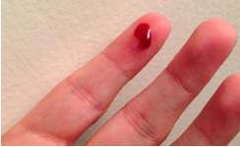
Personal Hygiene Practices (cont.)
Spilled blood
If an accident occurs where blood is spilled:
The area must be:
isolated
inspected
The line of equipment
cleaned
sanitised

Slide 29
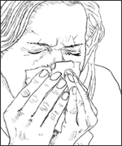
Personal Hygiene Practices (cont.)
Nose, Mouth and Ears
Around 40% of adults carry Staphylococci bacteria in their nose or mouth.
Coughing and sneezing can carry the bacteria in droplets for a surprisingly large distance.
Using disposable single-use paper tissues is preferable to handkerchiefs.
Discharges from the ears, eyes and nose may also contaminate product and sugar factory workers should see their Doctor if suffering from any of these infections.
Employees must not:
Cough or sneeze over or around the sugar product.
Pick or scratch their nose while working.

Slide 30

Personal Hygiene Practices (cont.)
Hair
As hair is constantly falling out this can result in sugar being contaminated and so sugar factory workers should wear a suitable head covering, with long hair being adequately tied back.
The combing of hair and adjustment of head coverings must not be done in sugar processing and handling areas.

Slide 31
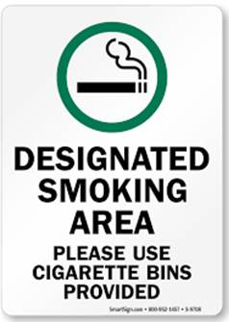
Personal Hygiene Practices (cont.)
Smoking
It is illegal to use tobacco, (e.g. cigarettes, pipes or cigars) in sugar production, handling and storage areas or while handling or delivering sugar.
Not only is this to prevent cigarette ends and ash from contaminating the sugar product, but also because:
People touch their lips while smoking and may transfer harmful bacteria to the product or from the product to their mouths.
Smoking encourages coughing and droplet infection.
Cigarette ends contaminated with saliva are put on working surfaces.
Smoking is a safety concern as a potential ignition source for dust grain explosions.
An unpleasant environment can be created for non-smokers.
In accordance with South African laws and regulations, no smoking is allowed in any areas within the factory premises.
Smokers are only allowed to smoke in designated smoking areas.

Slide 32

Personal Hygiene Practices (cont.)
Jewelry and Perfume
Sugar factory workers should not wear:
Earrings,
Watches,
Jewelled rings
Brooches
Jewelry can harbour dirt and bacteria
Gem stones and small pieces of metal may end up in the product
Strong smelling perfume should also not be worn, as it may taint the product.

Slide 33
General Health
Workers should be in good health
Do not work if you have wounds, cuts, flu or any transmittable disease that can affect food safety.
Any worker suffering from diarrhoea, vomiting or a food-borne infection MUST be excluded from work
Only return when you are completely free of symptoms for 2 days.
Stay away if symptoms return.
Workers with skin infections, sores, heavy colds and ear or eye discharge, must also stay away from work until the symptoms have gone.

Slide 34
General Health (cont.)
Sick personnel should stay away:
To prevent the contamination of the product
To prevent personnel from becoming even more ill since the factory environment is a dusty place with many different chemicals which can worsen their condition.
Consumers expect nothing less than healthy and safe food.
Food safety should not be compromised for quick gain.
Therefore as producers, processors and retailers; safety must be a priority issue.
Food that is handled or prepared by someone who is showing symptoms of sickness is not safe for consumption.

Slide 35

Food Safety Protective Measures
Food safety entails the handling, preparation and storage of food in ways that prevent foodborne illnesses
Sugar products must meet 3 basic requirements:
Free of contaminants
Of enough shelf life
Safe for consumption

Slide 36
Food Safety Protective Measures (cont.)
Eliminates food risks or reduces food risks to acceptable levels
Ensures food is safe for consumption
Ensures food will not cause harm to the consumer when it is prepared or consumed according to its intended use
Preserves the quality of food to prevent contamination and food-borne illnesses
Are applied throughout the supply chain – from the sugar cane farms to the sugar manufacturing plants until the final product is distributed and sold to the consumer.
Each sugar mill should have a food safety policy which states the company’s commitment and assurance to consumers to produce quality and safe products.

Slide 37


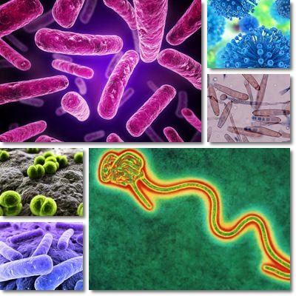
Types of Food Safety Hazards
There are three types of food safety hazards that can occur:
P - Physical food safety hazards
C - Chemical food safety hazards
B - Biological food safety hazards

Slide 38
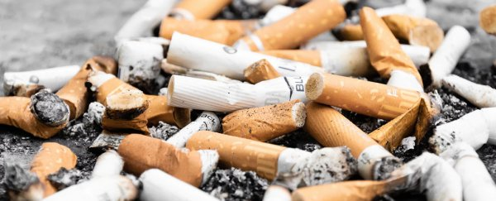
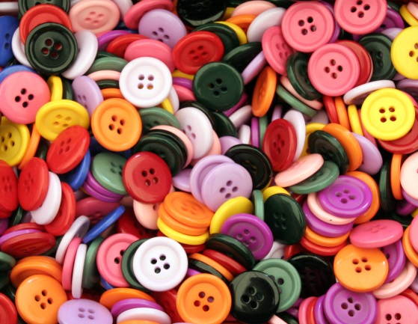
Types of Food Safety Hazards (cont.)
Physical food safety hazards
Physical contamination of the sugar product may be caused by dirt, hair, stones, soil, cigarettes or cigarette butts, nails, nuts and bolts, jewellery, match sticks, bone fragments, feathers, pieces of plastic or foil packaging material, stems, seeds, sticks and leaves, buttons, string and fibres or any other foreign substance.

Slide 39
Types of Food Safety Hazards (cont.)
Chemical food safety hazards
Chemical contaminants of the sugar product may include pesticides, medicines, detergents, disinfectants or any other chemical substance that could find its way into the food chain.
Residue monitoring and evaluation programs identify sugar containing harmful residues and remove these from the food chain.
These residues include toxins from natural sources, from pesticides, herbicides and fertilisers.
A number of agricultural chemicals (pesticides, herbicides, and fertilisers) may leave potentially hazardous residues in raw sugar cane.

Slide 40
Types of Food Safety Hazards (cont.)
Chemical food safety hazards (cont.)
Chemical contamination during manufacture is also possible.
Where compounds that might enter the food chain are known or believed to be hazardous, there are limits on the maximum amount that may be present in foods.
Pesticides: At the farm level, all crop protection products must be approved for their intended use.
They should only be used in accordance with the manufacturer’s instructions and any relevant codes of good practice should be observed.
Compliance with ‘harvest intervals’ should be ensured.

Slide 41
Types of Food Safety Hazards (cont.)
Chemical food safety hazards (cont.)
Pesticides (including herbicides, fungicides and wood preservatives) should be stored in an appropriate well ventilated and secure area.
This area should be constructed in such a manner as to contain spillages in the case of accidents.
They should be kept in the original container and not transferred to e.g. unmarked containers such as drink bottles.
Appropriate protective clothing and masks should be worn when handling, mixing or using these products, as indicated on the label of the product.

Slide 42
Types of Food Safety Hazards (cont.)
Biological food safety hazards
Biological contamination can be caused by bacteria, yeasts, protozoa, molds and viruses, which can enter the production chain as a result of poor sanitation and poor hygiene practices.
Bacteria and fungi are the principal types of micro-organisms that cause sugar spoilage and food-borne illnesses.
Sugar may be contaminated by micro-organisms at any time during harvest, processing, handling, storage or distribution.
The primary sources of microbial contamination are soil, air, humans, plant surfaces, water, and sugar processing machinery or equipment.

Slide 43
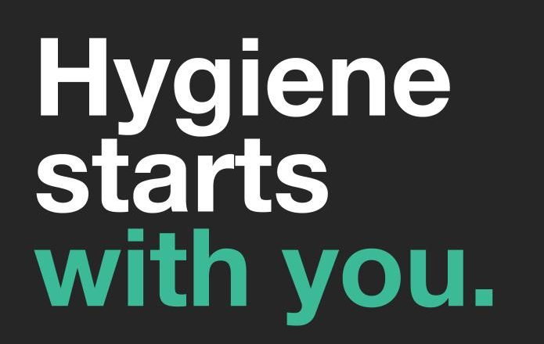
Conclusion
It is the responsibility of each role-player in the chain to ensure that the sugar product remains safe and of a high quality.
If each role-player in the chain keeps accurate records of what they did to the product while it was in their care, then it will be easy to trace any problems back to their source and, in so doing, solve the problem.
This is called “traceability”.

